Slide 1
Managing Money and Laws In An Ever-Changing Framework

Slide 2
Please Mute & Ask Questions on Chat ☺

Slide 3
Ask Any Time!

Slide 5
Gatherings In Facilities
Before you get excited about Stage 2 remember if you are in a council owned facility the “gathering” rule means in the whole facility, not just your part.
Hopefully there will be clarification in a couple of days for sports & other community groups from Queensland’s Chief Medical Officer.
Until then, be patient with Council and other landlords until we get the clearance necessary to help you get back to business.

Slide 6
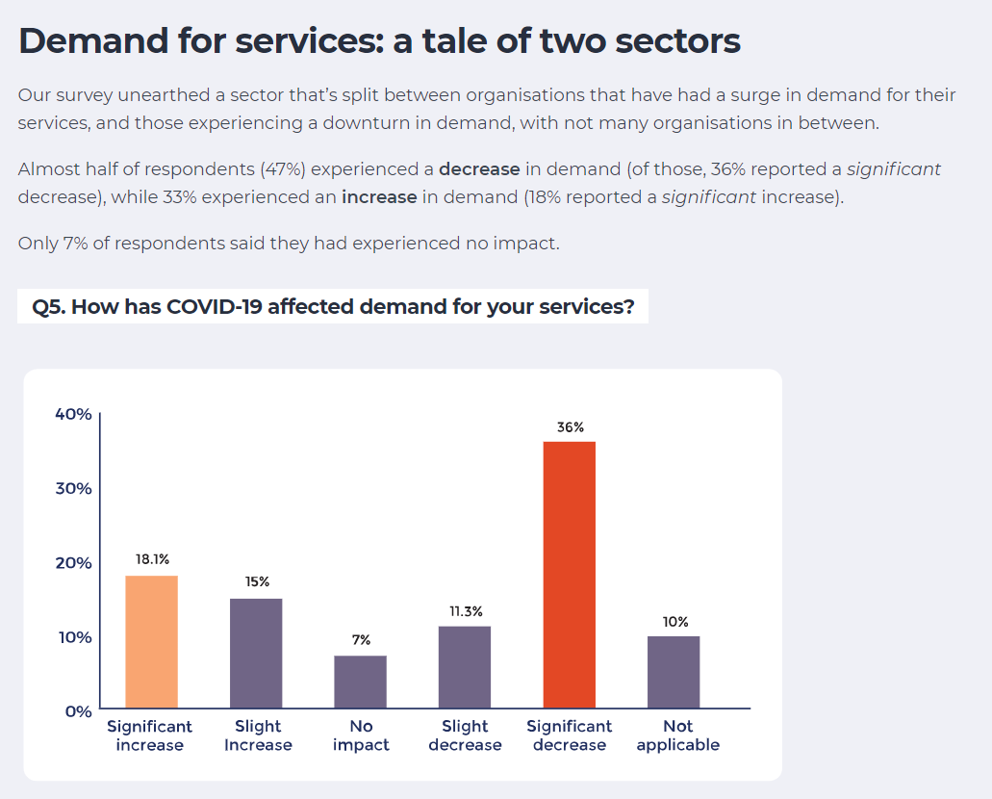
A survey on the impact of COVID-19 on the community sector in Australia highlighted that 70 per cent of Australia’s sporting clubs, arts and cultural organisations, community groups, welfare services and youth services feel “threatened” by the COVID-19 crisis.

Slide 7
“Return to Normal”
While some NFPs may be able to return to operations with only a couple of months out of action, for most clubs a return to operations WILL NOT look like it did prior to Covid.
Who participates, how they participate and how much they will pay could all change.
Funding opportunities could be available but competitive and volunteers could be less available.

Slide 8
Legal Aspects Of Club Money
Notes:
Must keep
Cash book or statement of all moneys received and paid (general Ledger)
Receipt book in duplicate, consecutively numbered
A register of official receipt books
Bank statements
Register of members
Register of assets
Petty Cash Book
Minute book
Supporting documents
Wage records
Expenditure ratification by the committee is required. Should show cheque numbers, payee and amounts.

Slide 9
Profit For Purpose
Increasing changes to the NFP business environment and even more to come (ACNC)
Volunteer status doesn’t protect you from failing to abide by relevant legislation
Non profit doesn’t mean you shouldn’t make one
Good committees understand they need to ensure the future of the business
Volunteers need to consider where they are best suited to volunteer
Too much focus on operations to the detriment of strategy

Slide 10
Whose Money Is It Anyway?
Your Committee responsibilities in managing finances.
Corporations & Association’s Law
Duty to act in the interest of the members, so should operate independently and free from influence
Act in good faith
Exercise due care & diligence
Ensure solvency (some leniency here around trading while insolvent during Covid)

Slide 11
Waiting for effect of Covid funding on turnover
Level Details | Audit Requirements | Insurance Requirements
Level 1 Turnover or Assets Over $100,000 per annum | Full Audit To The AIA | Must have public liability insurance Must advertise level of insurance
Level 2 Turnover or Assets Between $20,000 and $100,000 per annum | Accountant to confirm accounts (not full audit) | May choose not to have public liability Must advertise level of insurance
Level 3 Turnover or Assets Under $20,000 per annum | Treasurer’s Statement only (check with your organisation first) | May choose not to have public liability Must advertise level of insurance

Slide 12
Tax Free Status
Awarded by the ATO on request of your accountants
Relevant if income comes only from members
Can be repealed by ATO
Cost savings in accounting
Isn’t affected by registration for GST

Slide 13
Refunds, Covid & Consumer Laws
While ACCC has given some guidance about consumers being reasonable in their demands for refunds, ultimately ACL states that if you sell something that you then do not or cannot provide, a consumer can request a refund.
Attempting to squeeze a normal 20 round / 20 week competition into 20 rounds in 10 weeks may not be an acceptable compromise to a consumer.
No policy can override the provisions of ACL.

Slide 14
Financial Monitoring & Reporting
Notes:
Must keep
Cash book or statement of all moneys received and paid (general Ledger)
Receipt book in duplicate, consecutively numbered
A register of official receipt books
Bank statements
Register of members
Register of assets
Petty Cash Book
Minute book
Supporting documents
Wage records
Expenditure ratification by the committee is required. Should show cheque numbers, payee and amounts.

Slide 15
3 Basics Of Finances
Financial Monitoring
Reporting & Monitoring
Auditing
Financial Performance
Increasing Income
Decreasing Expenses
Financial Planning
Budgeting
Investment Strategies

Slide 16
Budgeting From Scratch
Key questions for you to try and estimate (do the best you can here)
What services or competition can you offer based on your conditions.
Lease conditions (can you do whatever you want, whenever you want? Eg Play on use space on extra nights?)
Availability of volunteers (will everyone have more or less time or money to be involved?)
How many of your usual members or clients will still want to access your services or competition if it doesn’t look like it used to?
What expenses are unavoidable, which are likely to increase (cleaning expenses, insurance) and are there any that might be funded or covered by grants?
What refunds might you be required to or decide to make?
What outstanding payments or bad debts might you have to deal with?

Slide 17
Insurance & Other Hidden Costs
Some insurances are based on income, not end of year profit (Eg Workcover) so watch for effects on these expenses when receiving funding, grants & support.
Eg: WorkCover considers that when an employer pays these additional amounts to workers, the payments are a top-up or subsidy payment and not a payment for work done. The additional amounts are paid to the worker so that the employer meets a condition that allows the employer to access payments under the JobKeeper Payment Scheme. Payments made for this purpose are not declarable wages.

Slide 18
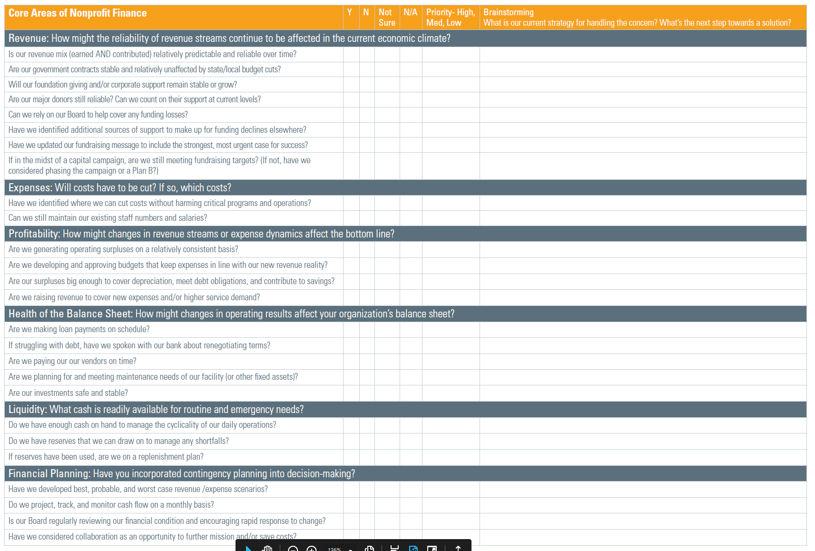

Slide 19
3 Basics Of Finances
Financial Monitoring
Reporting & Monitoring
Auditing
Financial Performance
Increasing Income
Decreasing Expenses
Financial Planning
Budgeting
Investment Strategies

Slide 20
Recording Transactions
Use
Use either computerised or manual system
Cash
Cash book to record payments & banking
Produce
Produce a profit & loss each month to show performance
Record
Carefully record what you owe & what people owe you
Use
Use Year To Date reporting
Make
Make sure new purchases are added to the asset register if necessary
Keep
Keep a “loan out” register of who has what equipment, uniforms etc
Get
Get volunteers to sign a list of what they have
Prepare
Prepare a policy on use of club resources

Slide 21
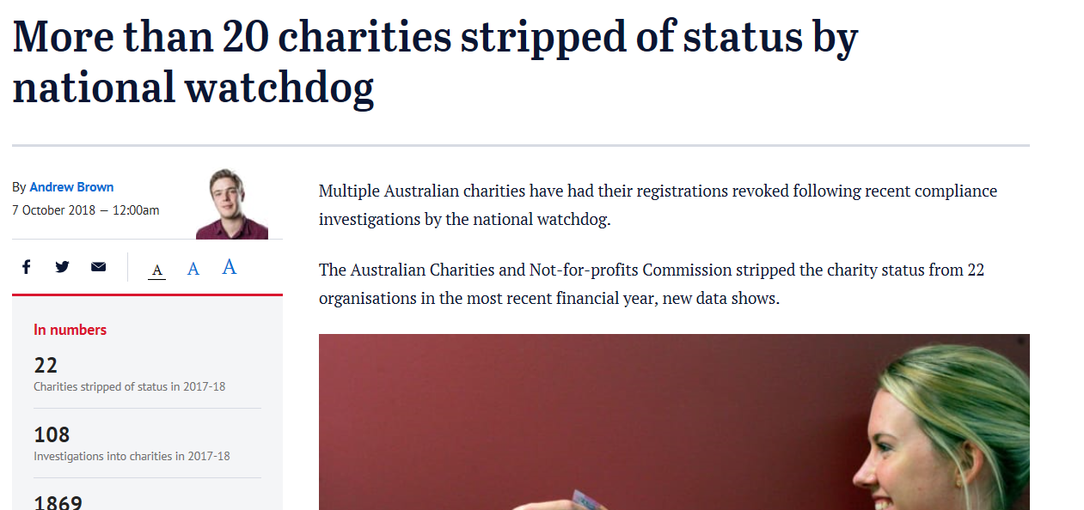
Don’t Ignore Usual Threats
The most common categories of concern related to fraud and financial mismanagement, including poor financial controls, inadequate due-diligence of employees and partners and a failure by the responsible persons to act in the best interest of the organisation…

Slide 22
Force Majeure Protections
Clauses in sponsorship and other contracts should always contain clauses that describe what will happen if either party cannot complete their obligations by events outside of their control. These clauses should also contain remedies Eg All deposits refunded; free transfer of dates
Venues where events are being held
Sponsors for events or any activity
Rental contracts or lease agreements

Slide 23
Monthly Financial Reports
At least original bank statement & cash book report
Best option
Profit & Loss Year to Date Vs Budget
Balance Sheet
Outstanding Debtors
Outstanding Creditors
Bank Reconciliation
Cash Flow

Slide 24
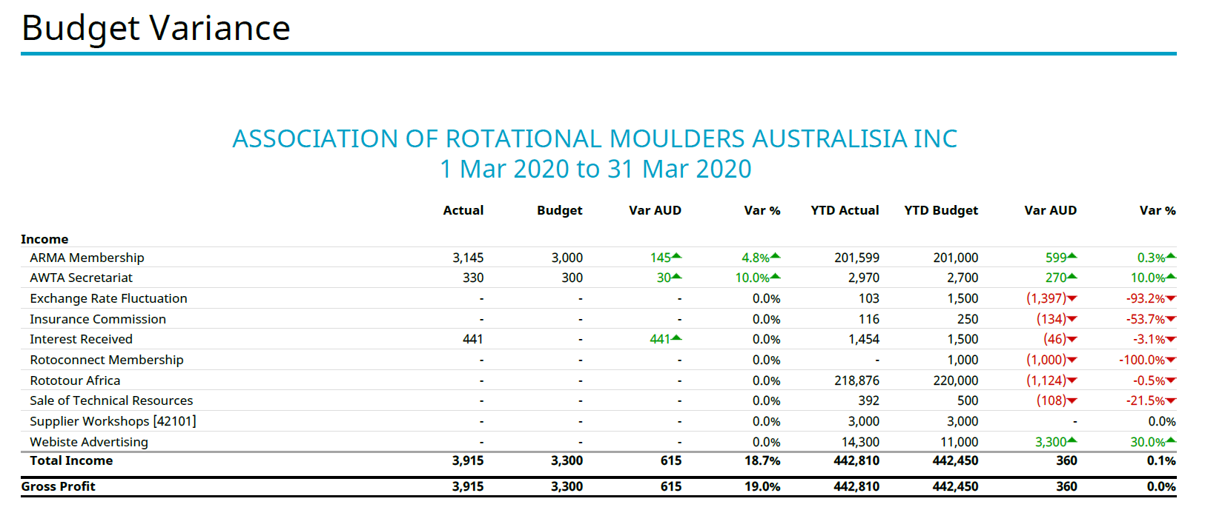
Profit & Loss YTD

Slide 25
Balance Sheet to Last Year

Slide 26
3 Basics Of Finances
Financial Monitoring
Reporting & Monitoring
Auditing
Financial Performance
Increasing Income
Decreasing Expenses
Financial Planning
Budgeting
Investment Strategies

Slide 27
Diversify Your Fundraising

Slide 28
Keep donors informed
Be proactive in personally communicating with donors, sponsors, vendors and volunteers about your current and upcoming events. Send emails, post on social media and share any changes to your operations or events on your website.
Let donors know what your organization is doing to protect the safety of everyone you serve. Thank them for their financial support, which is critical to your ability to respond in a timely manner and continue providing services.

Slide 29
Ask permission
If you postpone an event for which donations have already been received, ask donors and ticket holders for permission to apply these funds to the rescheduled event.
If the event is canceled, ask them for permission to apply their gift directly to mission-critical services.
If donors request a refund, send it promptly and cheerfully.
Let donors know you value them and hope they will support a future event.

Slide 30
Host an online event
Consider hosting an online auction if you’ve already secured donated items for a canceled event. There are several companies that manage online auctions. Do some research to find one that works best for your organization. Take photos of each item, post them online and invite donors to bid. You can schedule item pick-up in accordance with closures impacting access to your facilities.
Consider holding an online training event or conference and if possible even provide it for free.

Slide 31
Host a “non event”
Consider converting an in-person event to a virtual one. Sometimes referred to as a “non-event,” this involves sending an “invitation” to past and prospective event supporters asking for a gift in lieu of attending the event.
Be clever in asking for gifts that may replicate what donors might have spent to attend, such as a babysitter, or would have contributed at the event.
Keep the focus on your mission and who their generosity will benefit (it’s NOT about your fundraising goals).

Slide 32
Send donors love
Use this time to engage board and staff members in thanking donors for their loyalty and wishing them well during the crisis. Calls, personalized letters, hand-written notes and customized video messages sent via text or email are great ways to let donors know how important their support is to the people you serve, especially during times of crisis.
While acknowledging the seriousness of this outbreak, don’t hesitate to be clever in showering your supporters with some heartfelt donor love.

Slide 33
Capital campaigns
If your organization is involved in or about to launch a capital campaign, consider how the Coronavirus may impact the campaign plan, including donors’ ability to contribute and the cost of products & services as well as possible delays in delivery.
Consider utilizing an external consultants to provide advice and guidance regarding these decisions, including the importance of maintaining momentum.

Slide 34
Wash more than just your hands
Take time to clean up donor records, double-check addresses and remove inactive records to maintain an accurate database of past and present donors, volunteers and sponsors.
Making these improvements now will save time, reduce costs and improve results when events and communications return to normal again.

Slide 35
Look to the future
Now may be a good time to research new grant opportunities or fundraising strategies that you haven’t had time to pursue. Examples include learning more about generational differences and how they impact giving, best practices for direct mail, and updating your case for support.
All of these things will help your organization raise more money in the future.

Slide 36
ATO payment deferrals
For not-for-profits experiencing difficulties, the ATO can defer some payments by up to six months. Payments that may be deferred include income tax, activity statements, pay as you go (PAYG) instalments, FBT and excise payments. Contact the ATO's Emergency Support Infoline 1800 806 218 for more information on how to access this assistance.

Slide 37
JobKeeper Payment
Not-for-profit organisations, charities and businesses that have been impacted by the COVID-19 outbreak may be eligible to receive the Federal Government's JobKeeper Payment to retain their employees. The JobKeeper payment is valued at $1500 per employee per fortnight and for up to six months.
Key points:
Charities, including those with an annual turnover of more than $1 billion must demonstrate that their turnover has or will likely fall by 15% as a result of the covid-19 outbreak are eligible.
Universities and for-profit entities with an annual turnover of less than $1 billion must demonstrate a 30% decline in their annual turnover, while those with an annual turnover of more than $1 billion must demonstrate a 50% decline to be eligible.
Non-government schools and private vocational education providers are also eligible.
Charities can elect to exclude government grants from their JobKeeper turnover test by downloading and filling in the form on this page. Note: There are different lodgement closing dates depending on when you enrolled for JobKeeper payments. Charities that enrolled up to and including 13 June 2020 need to lodge by 20 June 2020. Those who enrolled on or after 14 June need to lodge within seven days of enrolling for JobKeeper payments.
Organisations must elect to participate in the scheme by making an application to the ATO. Note: 31 May 2020 was the final date to claim for wages paid in April and May. From 31 May onwards, a monthly business declaration must be made by the 14th day of each month to receive reimbursements for payments made in the previous month.

Slide 38
Boosting cash flow
As announced on 22 March, the government is providing up to $100,000 to eligible small and medium sized businesses and not-for-profits (including charities) that employ people, with a minimum payment of $20,000. These payments will help business and not-for-profit cash flow so they can keep operating, pay their bills and retain staff.
Small and medium sized business entities with aggregated annual turnover under $50 million and that employ workers are eligible. Not-for-profit entities (NFPs), including charities, with aggregated annual turnover under $50 million and that employ workers will now also be eligible. This will support employment activities at a time where NFPs are facing increasing demand for services.
Under the enhanced scheme, employers will receive a payment equal to 100% of their salary and wages withheld (up from 50%), with a:
minimum payment of $10,000 & maximum payment of $50,000.
An additional payment is also being introduced in the July – October 2020 period. Eligible entities will receive an additional payment equal to the total of all the Boosting Cash Flow for Employers payments they have received. This means that eligible entities will receive at least $20,000, up to a total of $100,000 under both payments. This additional payment continues cash flow support over a longer period:
increasing confidence; helping employers to retain staff; helping entities to keep operating.
The cash flow boost provides a tax-free payment to employers. We will automatically calculate it.

Slide 39
Superannuation guarantee amnesty
The super guarantee (SG) amnesty is a one-off opportunity to correct past unpaid SG amounts without incurring administration charges or penalties of up to 200% of the SG charge. The ATO work with organisations to establish a flexible payment plan. These arrangements include:
flexible payment terms and amounts which we will adjust if your circumstances change
the ability to extend the payment plan to beyond the end of the amnesty period. However, only payments made by the end of the amnesty period will be deductible.
Applications for the amnesty close 7 September 2020.

Slide 40
Indigenous Visual Arts Industry Support (IVAIS) Program
Indigenous Art Centres and Indigenous Art Fairs that currently receive funding through the the Indigenous Visual Arts Industry Support (IVAIS) Program will receive direct payments to maintain operations and employment levels, ensuring that they continue to support artists and their communities. This is part of a $7 million contribution to the (IVAIS) Program to help Indigenous Art Centres and Indigenous Art Fairs during the COVID-19 crisis and beyond.

Slide 41
Additional $10 million for the Regional Arts Fund
An additional $10 million for the Regional Arts Fund will provide crisis relief and targeted support to organisations, artists and arts workers that are critical to delivering the arts to communities in regional and remote areas. Funding will be delivered through the Government's Regional Arts Fund in the 2019–20 financial year.

Slide 42
Emergency financial relief for individual artists
1000x1000: Crisis Cash for Artists is a campaign led by Theatre Network Australia and facilitated by Creative Partnerships Australia through the Australian Cultural Fund to provide emergency financial relief to artists in need. Individual artists who have lost income due to COVID-19 may be eligible to apply.
Applications are accepted on an ongoing basis, and the Theatre Network Australia will strive to notify applicants within the week.

Slide 43
Arts Queensland Queensland Arts Showcase Program (QASP) funding increased by $2 million
The Arts Queensland Queensland Arts Showcase Program (QASP) funding pool has been increased by $2 million, funding caps per stream have been increased and the funding criteria has been expanded.

Slide 44
Community Support Package
The Federal Government has promised an additional $100 million worth of support to more than 300 charities. The $100 million is to be allocated over six months as part of a total $200 million community support package. The new relief package includes more than $37 million, to be shared across 200 existing federally funded emergency relief organisations. The funds would support service delivery, including phone support and outreach through home visits to enable organisations to safely drop off items such as vouchers and food parcels.

Slide 45
COVID-19 Rapid Advocacy Fund
Australian Progress, Australian Communities Foundation and Australian Council of Social Services (ACOSS) have launched the COVID-19 Rapid Advocacy Fund, a donor pool that can inject funds into advocacy campaigns demanding action in response to the pandemic in Australia to support grassroots community groups.
They encourage groups to pitch their projects as soon as possible. All grants will be approximately $3,000-$10,000.

Slide 46
Young Australian
The Foundation for Young Australians (FYA) has developed the COVID-19 Youth Response Fund to provide one-off grants between $5,000 and $20,000 to youth-led (aged 15-29) initiatives that are responding to the impact COVID-19 is having on young people. Both new and existing initiatives will be supported. Applications for Round 1 closed 15 May. Applications for Round 2 open 1 June and close 12 June.

Slide 47
Journalists & Radio
Support for Freelancers & Casual Contributors fund
The Judith Neilson Institute has created the Support for Freelancers & Casual Contributors fund to support journalists and provide some cost-relief to media organisations. Media organisations are invited to apply for financial support for freelancers and casual contributors to undertake specific projects. Applications are accepted on an ongoing basis.

Slide 48
Fresh Start For Independent Media
The ABC has established a $5 million Fresh Start Fund to provide urgent and critical support to independent Australian producers and safeguard local content and creativity during these unprecedented times. There are five streams of funding, ranging from approximately $6,000 to $25,000.

Slide 49
Small Business Relief Package
If your business or not-for-profit has been adversely impacted by COVID-19 your bank will allow you to defer principal and interest repayments for all loans attached to the business for a period of six months through the Small Business Relief Package.
To be eligible, you must have less than $10 million total debt to all credit providers. You need to be current, and not in arrears as of 1 January 2020.
Commonwealth Bank
NAB
Westpac
ANZ

Slide 50
Coronavirus Small and Medium Enterprises (SME) Guarantee Scheme
The Coronavirus Small and Medium Enterprises (SME) Guarantee Scheme will support up to $40 billion of lending to SMEs (including sole traders and not-for-profits) and guarantee 50% of new loans issued by eligible lenders to SMEs. The Scheme will be available for new loans made by participating lenders until 30 September 2020.
Loans will be made available through participating bank and non-bank lenders.

Slide 51
Sport and Recreation COVID SAFE Restart Plan Package
COVID SAFE Active Clubs Kickstart: For hygiene supplies, equipment and operational costs for COVID Safe clubs to return to sport. ($2000)
FairPlay vouchers : For young participants to participate in local sporting activities and support families experiencing hardship as a result of COVID-19.
Active Restart Infrastructure Recovery Fund: Grants for minor capital works and support for clubs to purchase revenue generating equipment to support Return to Play. ($20,000)
Gambling Community Benefit Fund: The GCBF provides incorporated, non-for-profit organisations up to $35,000 to help provide services, leisure activities and opportunities for Queensland communities. There are 5 funding rounds per year, and the next round closes at 11:59pm on 30th June 2020.

Slide 52
Ask Any Time!

