Slide 2
Grants Connect 2024

Slide 4
Regional Arts Development Fund Paul Brinkman Arts & Culture Manager

Slide 5
The Regional Arts Development Fund (RADF) is a partnership between the Queensland Government and Noosa Shire Council to support the development of local arts and culture in regional Queensland. RADF supports local arts and cultural development opportunities by providing project-based financial assistance to groups, individuals and businesses.

Slide 6
- Have a project idea - Read guidelines and application form - Talk to a grants officer - Develop your idea and gather support information – quotes, budget, commitment from partners etc. - Fill out application form (online – SmartyGrants) - Ask for help if you need it - Submit application - Await outcome
RADF Process

Slide 7
Must - employ an artist - have a quality arts outcome - have a development aspect - provide benefit to Noosa shire Funding Priority Areas (2023-24) - Arts Makes Social Impact - Arts Activates Spaces How much? Up to $7500
RADF Key Points

Slide 8
Applicant - Must have ABN (or Auspice) - Over 18 (or with parental support) Project - Must provide quality arts outcome - Must provide opportunities for artists, audiences and communities Suitable expenditure - Artist fees (industry rates), venue hire, material costs, some travel costs, some marketing and documentation costs Ineligible expenditure - Amateur art activities, entertainment, publishing, catering, framing and freight, operational costs, prizes and fundraising, administration costs
RADF Eligibility

Slide 9
RADF Key Dates
RADF Round 21
Accepting applications | 1st February to 14th March
Results announced | The day after the June Council meeting
Project delivery period | 1st July 2024 to 30 June 2025
Acquittal due | Within 30 days of project completion

Slide 10
Regional Arts Fund (Flying Arts) *only for hinterland areas of Noosa Shire - Quick Response (monthly Feb – Nov) - Community Projects www.flyingarts.org.au/raf/ Arts Queensland - Queensland Arts Showcase Program (QASP) - Touring Queensland Fund - Organisations Fund - Strategic Partnerships Fund www.arts.qld.gov.au/aq-funding Australia Council - Various www.australiacouncil.gov.au/funding Australian Cultural Fund – – crowd funding platform www.australianculturalfund.org.au
Other Arts Grants

Slide 11
Community Grants Meagan Monk Grants Officer

Slide 12
Overview of Community Grants
The Community project grants are for projects, programs, events, equipment purchases and building/ground works.
Min - Max grant: $1,000 to $30,000.
Frequency - Twice Yearly
Round 21 opened 1 February and closes 14 March.
Round 22 will open 6 August and close 17 September.

Slide 13
Before You Apply
Read the Guidelines and Eligibility Criteria. Speak to a Community Development Officer (not compulsory) – they may be aware of other funding sources, masterplans and strategic plans.
Plan your project with your committee (who will do what, obtain quotes, how much $ can the club commit, can you provide any in kind works, schematic/site/building plans, project plan and timelines, letters of support and committee agreement.
Find out who owns the land where the project or event will take place. Seek permission from the land-owner to complete the project or event (in principle support). May need to speak to Council’s Building, Planning or Heritage team. If there is a shortfall in funding, how would you address this?
Have no outstanding debt to Council
Have met all previous acquittal conditions for previous grants

Slide 14
Budget
Ensure you have your quotes before you start the application
Between $1,000 - $7,499 1 quote, Over $7,500 2 quotes.
All amounts in the budget must not include GST
The income and expenditure should balance in the budget
If you can contribute in-kind – work out the value E.g. Volunteer Labour $44 per hour x 10 hours = $440
In Kind must be the same value in income and expenditure in the budget.
Fill in expenditure side first to calculate your project expenses, then fill out income to identify where funds will come from and how much.
Itemise your expenditure items in your budget. Not one bulk amount for the entire project – break it down.

Slide 15
Meagan Monk
Grants Officer
grants@noosa.qld.gov.au
(07) 53296437

Slide 16
Youth Response Grant Josiah Tharps Community Programs Officer

Slide 17
Youth Response Grant
*
Projects with a focus of young people 12-25
support community organisations to better engage with young people across the Shire
provide avenues for young people to guide the development of activities and programs related to their sector
provide services, activities and events that support the needs of young people
create opportunities for young people to develop new connections

Slide 18
Youth Response Grant
Youth-led creativity, entrepreneurship, innovation, active citizenship and social cohesion
Youth Grant
Accepting applications | 1st February to 14th March
Results announced | 26 March 2024
Successful applicants submit funding agreement | No later than 30 May 2025
Project delivery period | 30 March 2024 to 30 March 2025
Acquittal due | Within 30 days of project completion

Slide 19
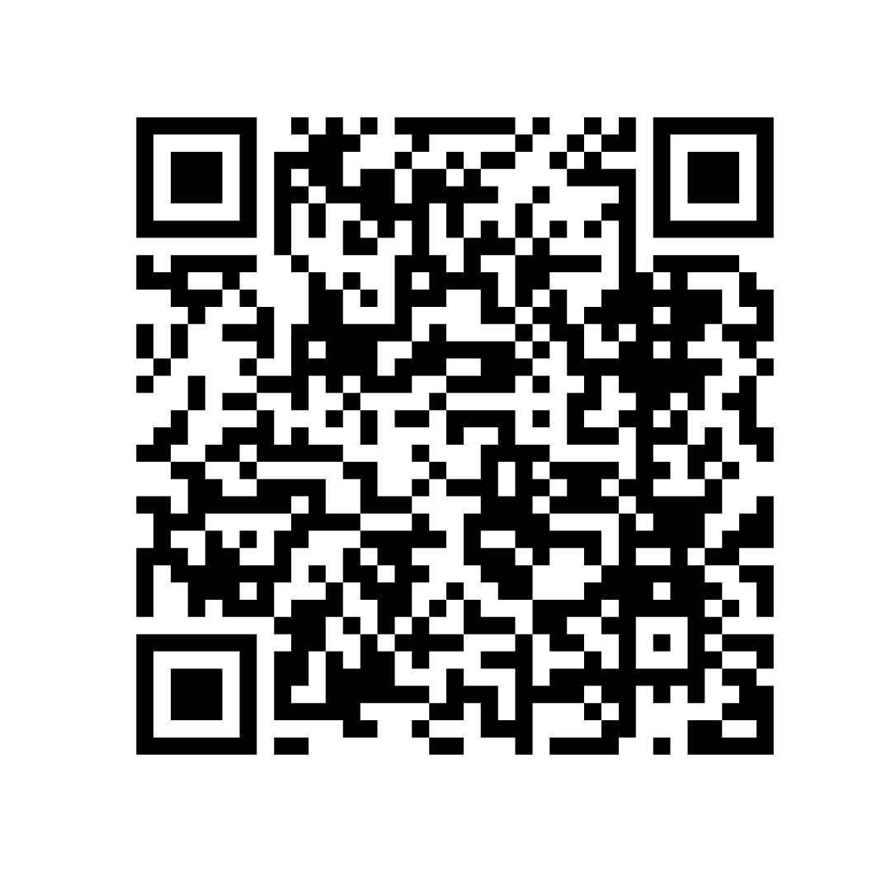
Youth Grant Guidelines

Slide 20
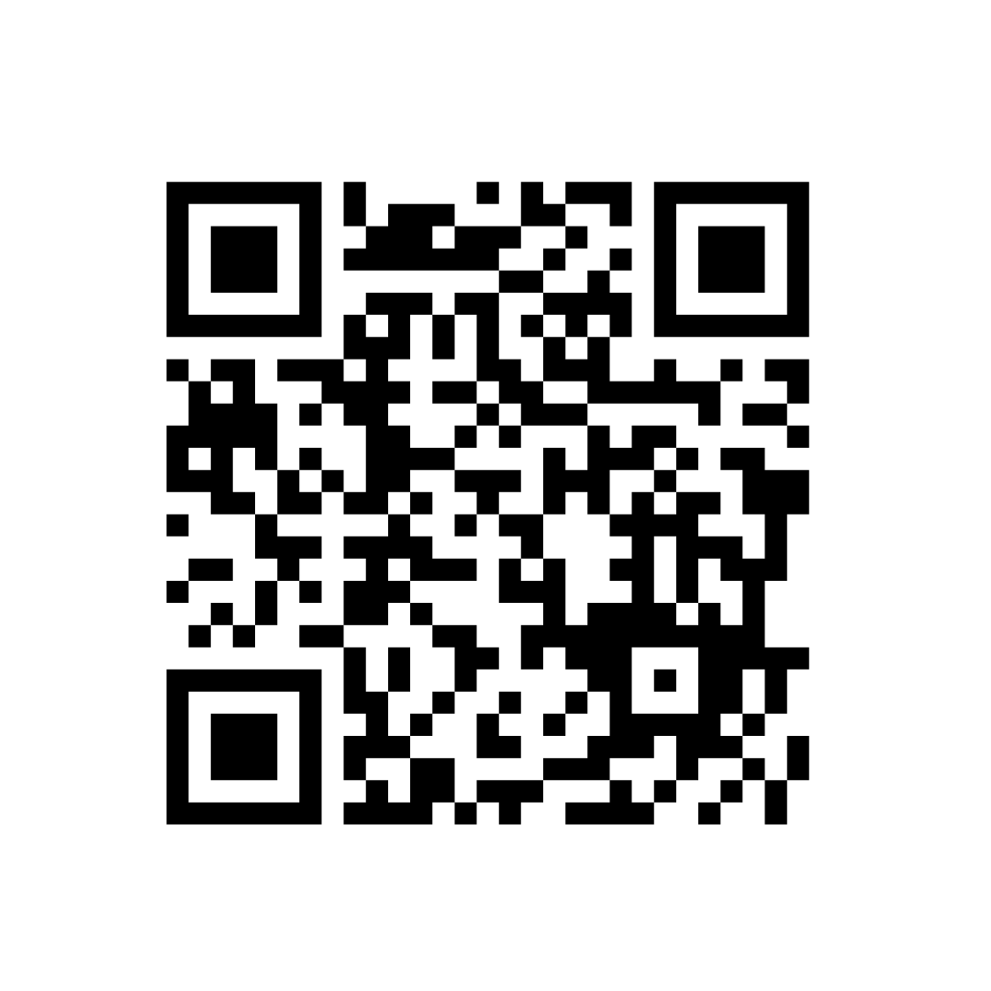
Youth Grant Application portal

Slide 21
Eligible organisations
Are a legal not-for-profit organisation as defined by the Australian Taxation Office (ATO) and Australian Charities and Not-For-Profits Commission (ACNC) which are:
An incorporated association
A company limited by guarantee
A non-trading/non-distributing co-operative
An Indigenous corporation
Comply with all governance and financial requirements of the State and Commonwealth as at the closing date for the grant program
Have an active ABN in the name of the legal entity o Have a bank account in the name of the legal entity

Slide 22
Not Eligible Organisations
• Commercial businesses or business trusts
• Individuals
• Government agencies or departments of local, state or federal government
educational, political or religious organisations, or primary health care providers,
where the application is for the organisation’s core business
• Parents and Friends Associations, or Parents & Citizens Associations
• Kindergartens, Pre-school and day care centres
• Not for profit organisations with a liquor-licensed supporters/associated club that
commercially trades seven days a week
BUT

Slide 23
Auspicing
Apply under the auspice of an eligible organisation.
If the application is successful, the auspice organisation will take full legal and financial responsibility for the delivery of this project and the grant administration.

Slide 24
Projects
Youth led community events
Projects that focus on reaching disengaged and disadvantaged young people
Education, employment, training and life skill development
Mentoring, crime prevention, youth justice
Art and Culture

Slide 25
Funding
Minimum grant amount from Council is $1,000 and maximum grant amount is $30,000
Budget items over $7,500 two written quotations are required
Provide a realistic and complete project budget

Slide 26
Josiah Tharps Community Programs Officer Josiah.tharps@noosa.qld.gov.au

Slide 27
Environment, Climate Change Grants Ben Derrick

Slide 28
Overview of Environment, Climate Change Grants
Working with and supporting Noosa community to achieve significant environmental outcomes.
Environment Project Grants
Climate Change Project Grants

Slide 29
Funding Priorities
All initiatives funded by Environment Grants programs will have tangible and measurable outcomes that:
Increase capacity of local groups to collaboratively approach environment Management initiatives.
Enables collaboration with community in initiative that work toward the outcome and targets identified in the Noosa Environment Strategy and Noosa Climate Change Response plan.
Support the implementation of the Noosa Environment Strategy and other Noosa Council environmental strategies and plans.

Slide 30
Environment Project Grants
Min - Max grant: $1,000 to $30,000.
Support initiatives with duration up to 12-month.
These grants will be for projects, programs or events that align with the Noosa Environment Strategy.
Biodiversity
Waterlands, Wetlands & Coasts
Sustainable Living
Climate Change adaptation & resilience

Slide 31
Climate Change Project Grants
Min - Max grant: $1,000 to $30,000.
Support initiatives with duration up to 12-month.
These grants will be for projects, programs or events that align with the Climate Change Response Plan.
Leadership & Governance
Energy efficiency & governance
Clean low emissions industries
Reduce emissions & resource consumption
Zero waste & circular economies
Resilient & adaptive communities & built environments
Sustainable agriculture
Health & resilient natural systems & carbon sequestration & food systems

Slide 32
Key Dates
Round Opens Thursday 1st February 2024
Round Closes Thursday 14th March 2024
Results Announced Mid June 2024
Project Delivery Period 1 July 2024 to 30 June 2025
Acquittal Period Within 30 days of project completion

Slide 33
Assessment Criteria
Demonstrated need for the project ​
Demonstrated need for funding ​
Contributions, financial or in kind, toward the project ​
Benefit to the Community ​
Alignment to Council’s strategic goals and identified key initiatives: ​
Capability of the organisation to deliver the project

Slide 34
Grant Tips
Read relevant Grand Guidelines to check what is the correct grant for your project.​
Check your eligibility in program guidelines.​
Contact Environment Service Officer about your project at environment@noosa.qld.gov.au​
Projects that already commenced will not be funded. ​
Applications cannot be submitted after closing date and time.

Slide 35
Sarah Watson
Project Support & Administration Officer
environment@noosa.qld.gov.au
(07) 5329 6253

Slide 36
Economic Development Grants Lynne Banford

Slide 37
Foundation Documents
Noosa Council Corporate Plan 2023 – 2028
Noosa Shire Economic Development Strategy 2021 - 2030 (Smart Biosphere)
Economic Development Grants Policy 2023
s
Notes:
-FOUNDATION DOCUMENTS
-Corporate Plan talks about Liveability, Prosperity and Future
-Smart Biosphere Strategy talks about transition and building resilience
-It is from the Smart Biosphere Economic development Strategy that the grants Programs belongs

Slide 38
Grants Program
Project based grants that support our local businesses and economy
Open all year round
Maximum of $5000 per application
NFP’s and For profit companies can apply – as long as there is local community benefit
s
Notes:
ED Grants program is a little different from the Communities Grants Program
Open all year until the budget is expended - we can always apply for mor money if we over subscribe – we’d love to have that problem!
Talk to the points – stressing that whilst for profit companies can apply they are not allowed to use the ED grants to make a profit out of the project
There are other criteria& timelines in the guidelines so please make sure to read them carefully

Slide 39
Programs that grants have supported
Young Entrepreneurs Program
Mental Health workshop for small business owners
Green Skills Careers Expo
Skills workshop for micro businesses
s
Notes:
-So for example, These are project based grants that have over the past 8 years supported a wide range of local projects including:
A mentoring and skills development program specifical for young entrepreneurs with a business idea
Workshops such as the Mental health Workshop for small business owners delivered by the Noosa Chamber
Skills workshop for small businesses which taught businesses how to use AI in their businesses
Careers expo specifically for green businesses showing students pathways for this growing and emerging sector (who currently don’t have the requisite skilled staff)

Slide 40
How to apply
Read the Policy and Guidelines
Talk to our ECDEV Grants Officer
Applications are assessed by Council staff
s
Notes:
How to apply
We aim to make the process easy and efficient whilst still making sure that the criteria are met and that we are funding worthwhile projects.
Before any application, we expect applicants to have a conversation with our ECDEV Grants Officer who can provide feedback as to the project and guide you through the application process
We have a rigorous internal process - Applications are then assessed internally by objective Council staff and signed off by our director
We promise an assessment turnaround of 30 days!

Slide 41
Your application
Supported by data – economy.id
Must demonstrate a benefit to the local economy
Looking for projects that create:
Pathways, partnerships, skill development and business capacity, collaboration, business support, innovation & entrepreneurship s
Needs to be acquitted within 30 days of project completion
Notes:
A good application has data that supports their projects
Council subscribes to an online service called economy.id which has a range of demographic, and economic information that’s helpful for applications
We are keen to work with organisations with projects that support our Smart Biosphere such as
pathways to jobs, partnerships with our local chambers and industry groups ,
programs that build skills and capacity for our local businesses,
projects that create networks that collaborate and encourage innovation and support entrepreneurship

Slide 42
Thank you
For more information on Grants
and economy.id
www.noosa.qld.gov.au/business
Or call us!
s

Slide 43
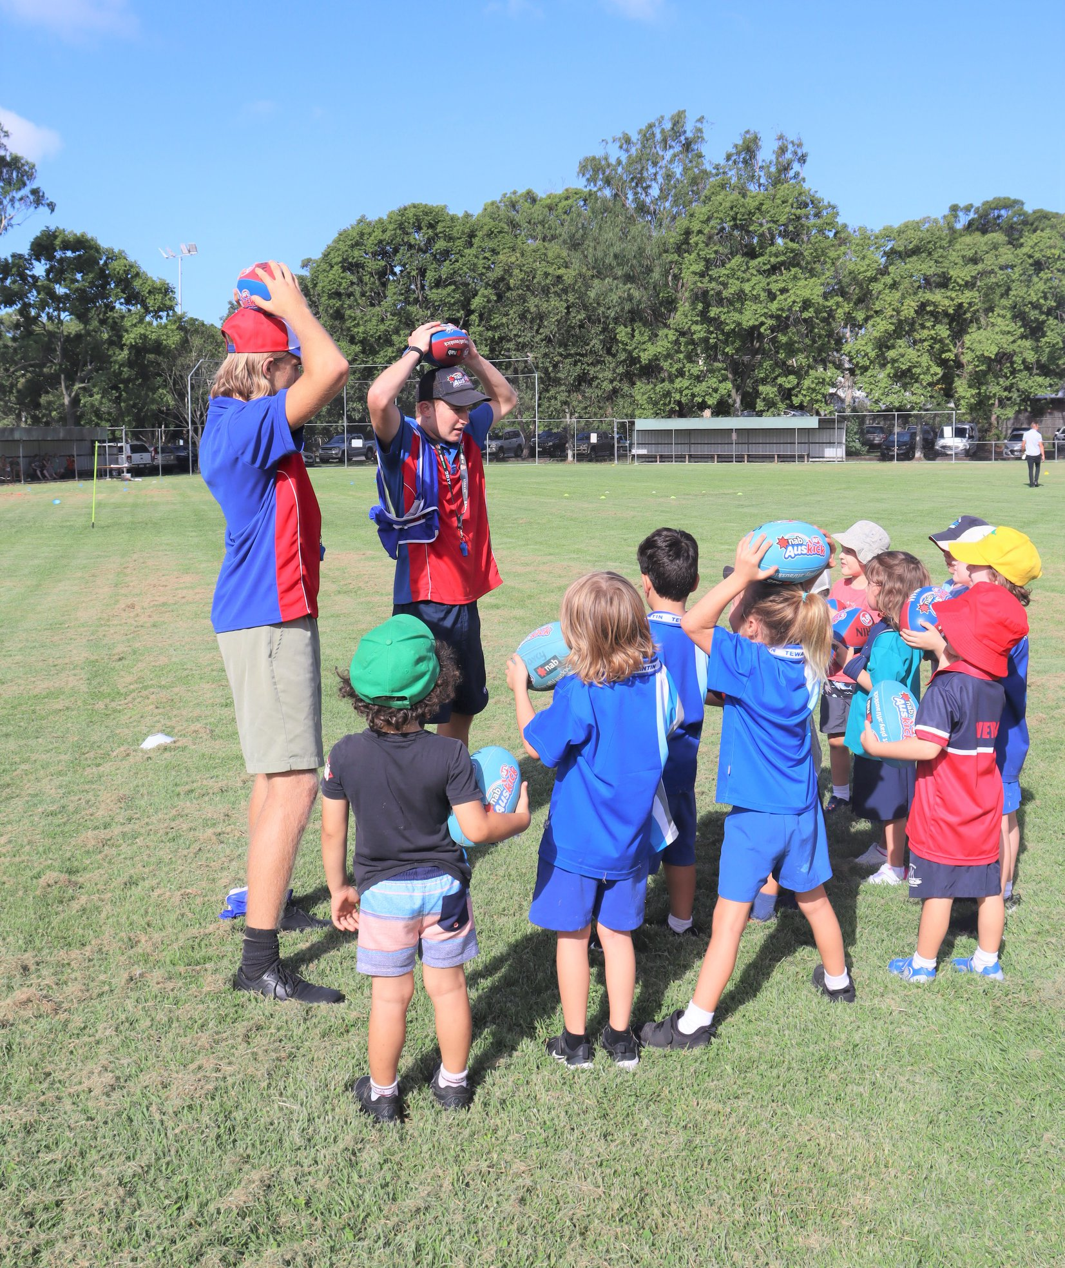
Community Infrastructure Process Margit Cruice

Slide 44
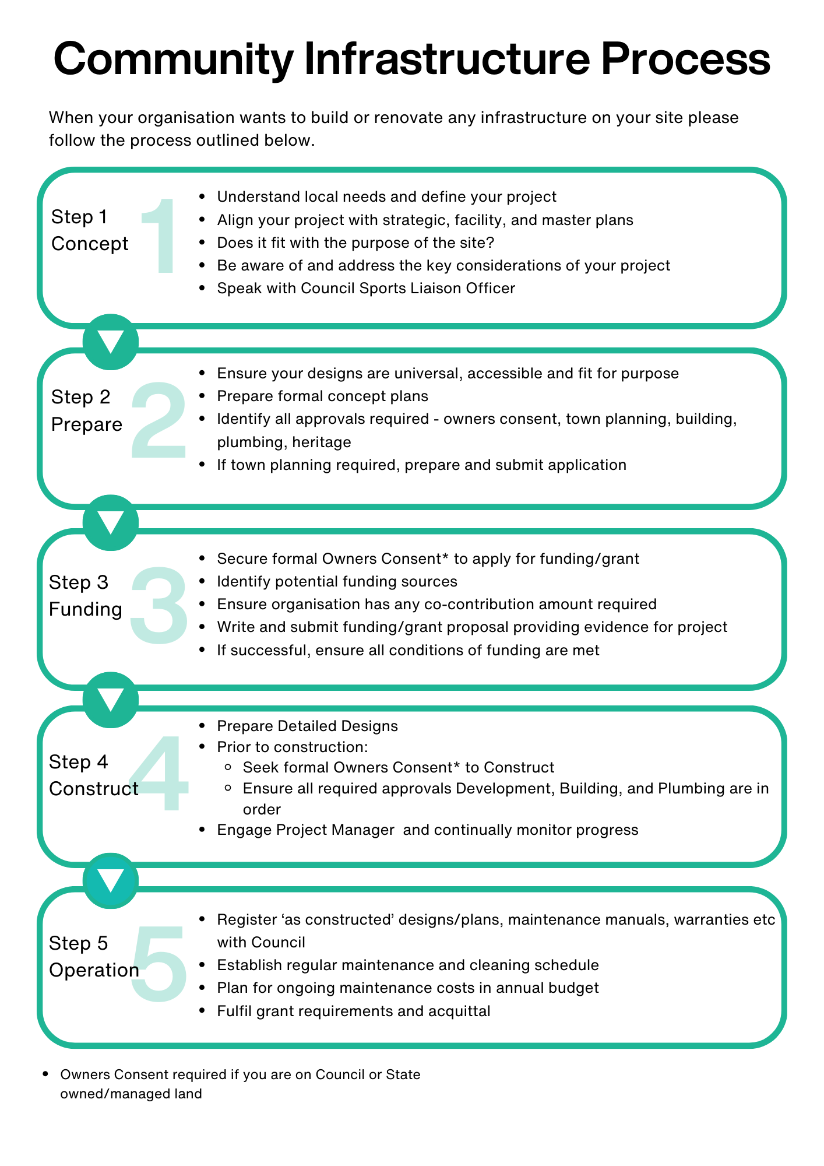
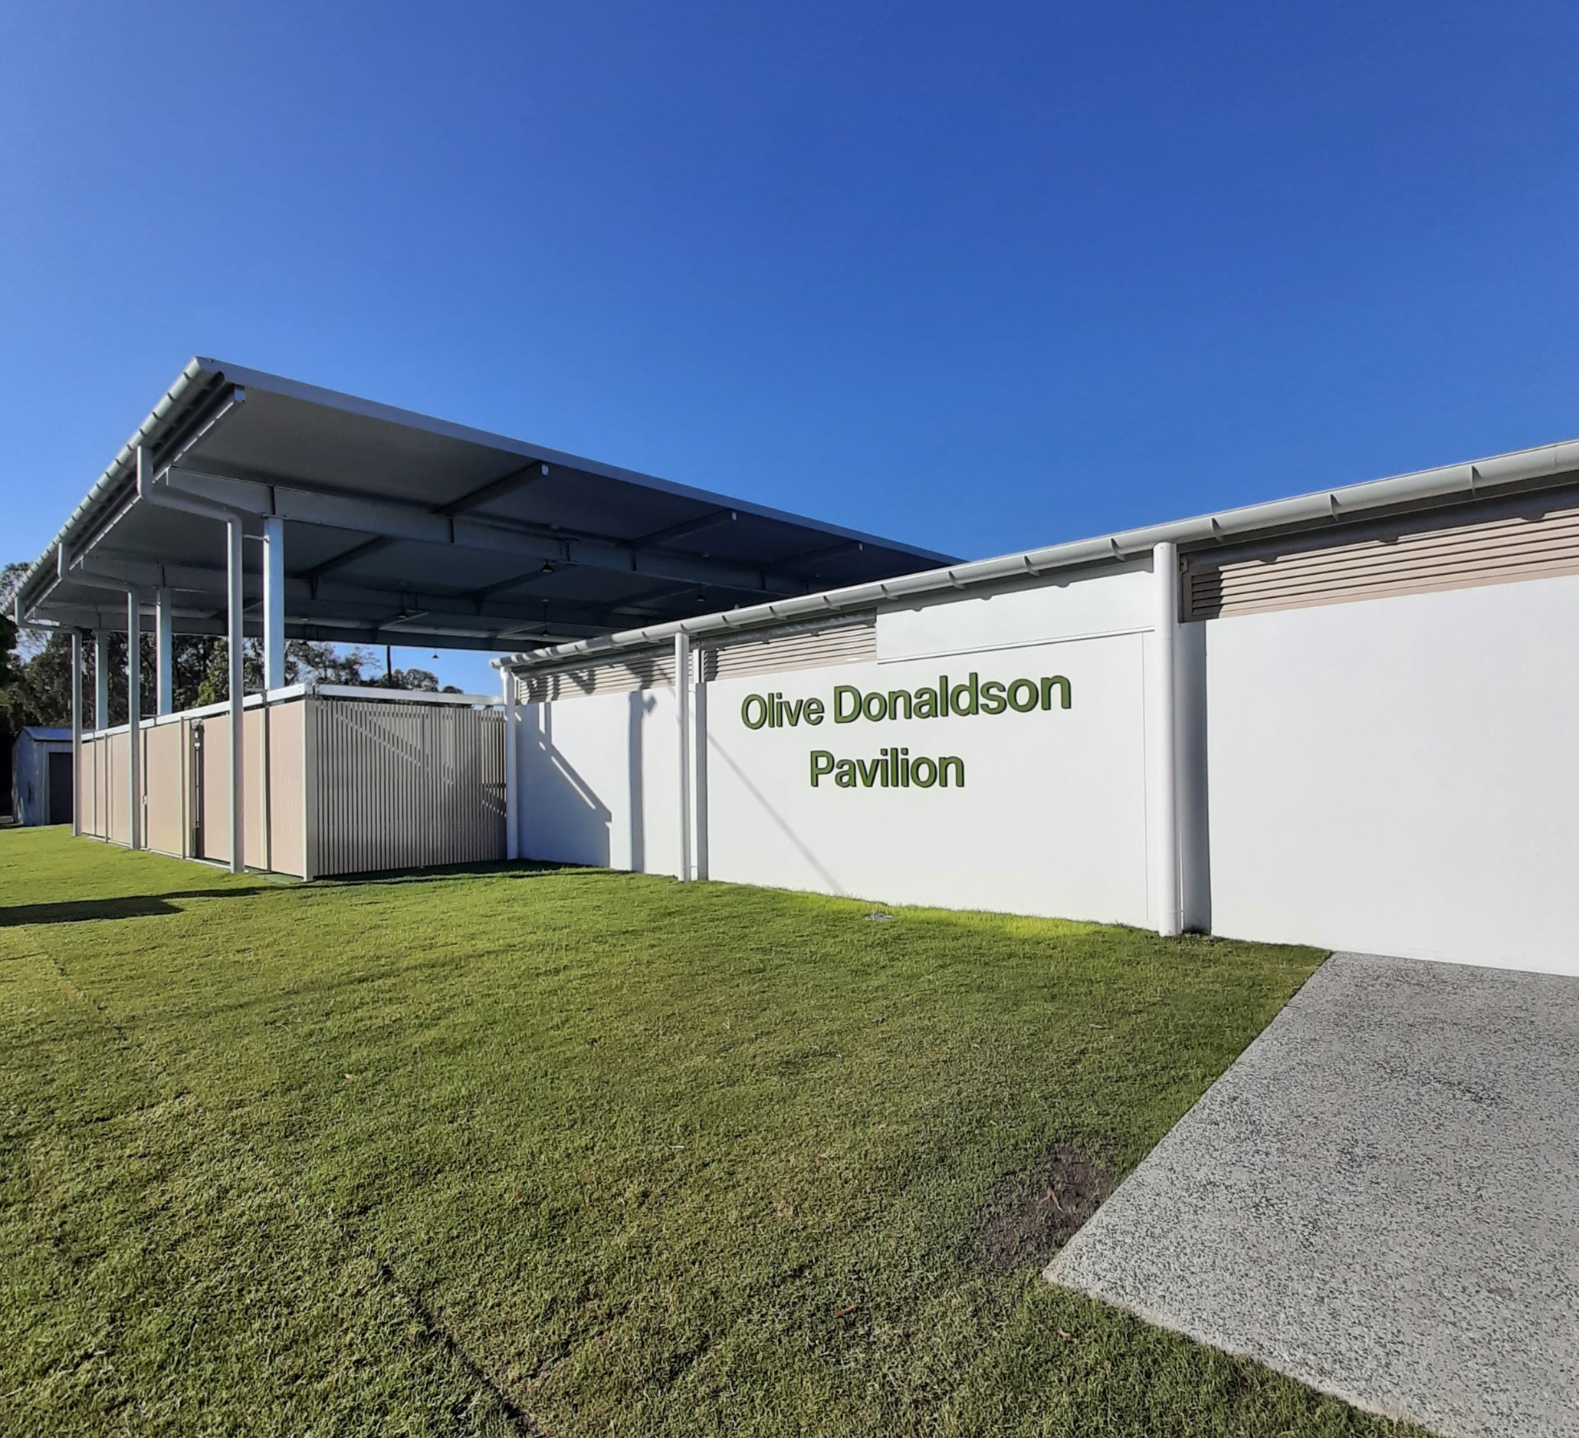

Slide 46
Noosa Community Foundation
Supporting, not Competing with, Noosa Region Charities

Slide 47
Mission
“The Noosa Community Foundation will raise charitable donations directly and indirectly by support for others and work collaboratively to disburse donations efficiently, effectively and transparently so as to maximise the beneficial impact from charitable giving in the Noosa region while respecting the preferences of donors for the management and distribution of their funds.”
Mission Plank 1: generate more charitable giving in the Noosa region
Mission Plank 2: provide services that reduce the administrative load on local charities
Mission Plank 3: increase the efficiency & impact of charitable giving in the Noosa region
reception@noosa.foundation https://noosa.foundation

Slide 48
Possibilities
Below is a limited list of some of the services we might be able to add to Noosa charities’ toolkits.
Accepting bequests on behalf of local charities and preserving indefinitely
Giving Circles, monthly donations etc services on behalf of local charities
Marketing assistance
Software systems
Accepting large donations and parceling out as smaller ones to a portfolio of charities of the type the donor likes
reception@noosa.foundation https://noosa.foundation

Slide 49
Support for charities
The DGR1 charities we are aware of servicing the Noosa region are on our website
If you know of others please drop us an email
We only contribute to local charities and to external ones which demonstrably spend our donations in the Noosa region
Donors can donate to;
Via us, to a specific charity
To a Panel (group) in the same area (e.g. Environmental) and we distribute across the group
United donations which we allocate (presently) to charities with long term benefit like e.g. scholarships
reception@noosa.foundation https://noosa.foundation

Slide 50
Philanthropy fund founded in 2004…. Celebrating 20 years
Managing Buderim Community Grants & Thompson Charitable Fund grants on the Sunshine Coast
Receives donations and bequests – money in Carefully invests the funds to generate income – money managed Distributes income as Grants (from 2008) to Buderim based community organisations – money out
10 Board of Directors and 8 working committees
Approx 50 local volunteer their time and talent as directors and committee members
We also have key sponsors like Sunshine coast Toyota, Edenlea on Buderim, and Buderim Pharmacy

Slide 51
$1,714,589 inserted back into the Sunshine Coast community
Buderim Foundation
Community Grants
(up to $10,000 per participant)
Eligibility: The organisation is a not-for-profit community organisation, whose project directly benefits residents in the 4556 post code area.
Criteria:
Protects and preserves natural environment
Assists people in living healthy & fulfilling lives
Add richness and diversity to local artists and culture
Increases learning opportunities across all age groups
Celebrates our heritage and local history
Encourages and supports sport & recreation interests
Strengthens the social fabric of the community
Supports youth in our community
Thompson Charitable
Fund Grants (up to $250,000 p.a.)
Eligibility: The organisation is a not-for-profit organisation with DGR status, registered with ATO as a charity, whose primary purpose is to care for people in necessitous circumstances (those experiencing financial hardship) across the Sunshine Coast.
Criteria:
The provision of support or relief to people suffering financial hardship must be the principal purpose
Must disclose the Constitution and ATO letter
Description of the organisations activity and financial spend on each category
Grants monies must provide direct relief to the persons in hardship, eg food, accommodation, money
Actively Seeking Volunteers on the Sunshine Coast

Slide 53
Overview of the fund
The Gambling Community Benefit Fund (GCBF):
is Queensland’s largest one-off community grants program
distributes approximately $60 million each year to not-for-profit community groups across a wide range of sectors to enhance their capacity to provide services, leisure activities and economic opportunities for Queensland communities

Slide 54
Funding Rounds
Funding rounds and closing dates are available on our website
Applications open 5-6 weeks prior to the closing date
In 2024
Round 120 - $35,000 standard grant round
opened 31 January
closes 29 February
Other rounds - to be announced

Slide 55
The steps to success
Step 1: Plan
Step 2: Prepare
Step 3: Write and submit
Step 4: Assessment
Step 5: Funding decision

Slide 56
Step 1: Plan
The organisation needs to be eligible
The application needs to be eligible
The items you are applying for need to be eligible

Slide 57
Is my organisation eligible?
To be eligible, your organisation must meet the requirements of either a legal entity or a sponsored entity
A legal entity must:
be incorporated or registered under an Act of Parliament
have an active ABN
have not-for-profit objectives
have a bank account in the name of the organisation
provide a bank verification form stamped by the organisation's financial institution

Slide 58
Is my organisation eligible?
To be eligible, your organisation must meet the requirements of either a legal entity or a sponsored entity
A legal entity must:
be incorporated or registered under an Act of Parliament
have an active ABN
have not-for-profit objectives
have a bank account in the name of the organisation
provide a bank verification form stamped by the organisation's financial institution

Slide 59
Ineligible organisations
Organisations that are not eligible for funding are:
state, private or independent schools (this excludes P&Cs and P&Fs)
proprietary limited or public companies limited by shares, or trusts where the shareholders are individuals or for-profit companies
individuals (sole traders)
organisations trading for profit
You are also ineligible for funding if your organisation:
has duplicate registrations in the online portal
does not provide information we request by the due date
does not update the financial details registered with us before applying

Slide 60
Is my application eligible?
Yes, if it…
Demonstrates a benefit to Queensland communities and meets the objectives of the fund
Is my application ineligible? Yes, if…
You are awaiting the outcome of a previously submitted application
You have a previously approved GCBF grant not yet acquitted
You recently acquitted a previously successful grant, so you need to wait one round before applying again
The application is missing information or is incomplete
The items requested were ineligible
Your organisation has submitted more than one application for the same location

Slide 61
Are my requested items eligible?
Yes, if they are …
any item, except those listed in the funding guidelines as ineligible

Slide 62
Ineligible items
Items purchased before notification in writing that the grant is approved (including paid deposits)
Grant writer fees or items purchased from a grant’s writer or their associated companies
Project management fees
Operating costs e.g., repayment of debts, recurring costs, contingency costs
Overseas travel
Goods or services that benefit an individual including funding for members or staff social events
Gifts and alcohol
Subsidies/Sponsorship
Items purchased from overseas suppliers without prior written approval

Slide 63
Items unlikely to be funded
Are my requested items unlikely to be funded?
Yes, if they are …
Salaries and wages
Rent and lease costs
Public liability insurance for events
Administration expenses
(e.g. stationery, postage etc)
Consumable items
(e.g. fuel, office supplies)

Slide 64
Funding Priorities
The committee has funding priorities and other determining factors to ensure that they consistently and fairly provide funding recommendations that support the objectives of the fund.
Your application will be sorted into funding priority, depending on the items for which you request funding.
Consider these priorities when planning your application:
Priority 1 - Organisation affected by natural disaster
Priority 2 - Facility improvements or equipment
Priority 3 - Vehicles (bus, car, caravan, boat etc)
Priority 4 - Community events, training, workshops, programs and festivals
Priority 5 - Organisations that have received GCBF funding of more than $15,000 in the last 2 years

Slide 65
The committee also consider the following factors:
Financial position and age of organization
Value for money of the grant
Contributions toward project
Ability to generate income
Benefits to more than one organization
Geographic location and benefit to region
Target group being assisted
Government priorities identified by the Minister

Slide 66
Step 2: Prepare
Check the website and/or social media for opening and closing dates
Prepare a realistic costing of the requested items using quotes
Consider other community groups that could use or benefit from your project
Contact referees for support
If you are undertaking a facilities upgrade, do you meet the criteria?
If holding an event, is the date of the event suitable for this application?

Slide 67
Step 3: Write and Submit
Explain why the grant is needed – in your own words
What is the specific objective your organisation aims to achieve with this grant?
Why does your organisation find these items essential?
How will your organisation directly benefit from these item/s?
In what ways will the broader community benefit from the acquisition of these item/s?
2,000 character limit
Show your application to someone else for checking
Make sure that during school holidays your contact is available
Don’t leave it to the last minute to submit!

Slide 68
Step 4: Assessment
Your application will:
Be assessed against the funding guidelines
Be presented to the Gambling Community Benefit Committee for consideration and recommendation
Be provided to the responsible Minister for approval
Receive an outcome approximately four to five months after the closing date

Slide 69
Step 5: Funding Decision
Outcome letter (approved/unsuccessful/ineligible) will be emailed to the Accountable Officer
Check the portal to determine which items have been funded prior to purchasing the approved items
If you need to vary the grant refer to the website for instructions

Slide 70
Need help? Contact us!
www.justice.qld.gov.au/grants
1800 633 619
cbf@justice.qld.gov.au
Keep up to date – follow on Facebook
https://www.facebook.com/gcbfqld

Slide 71
Built by Queenslanders for Queensland

Slide 72
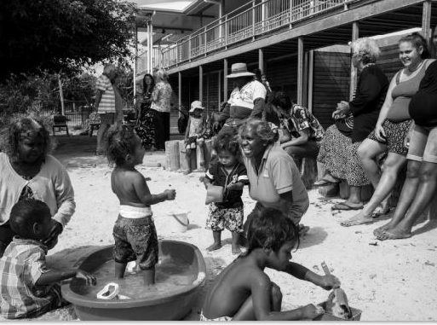
Our Vision
To lead community giving in Queensland
Our Purpose
To benefit all Queenslanders by building, encouraging and celebrating community giving
“Puuya” by Russell Shakespeare2019 QCF Philanthropy in Focus Photo Challenge entry

Slide 73
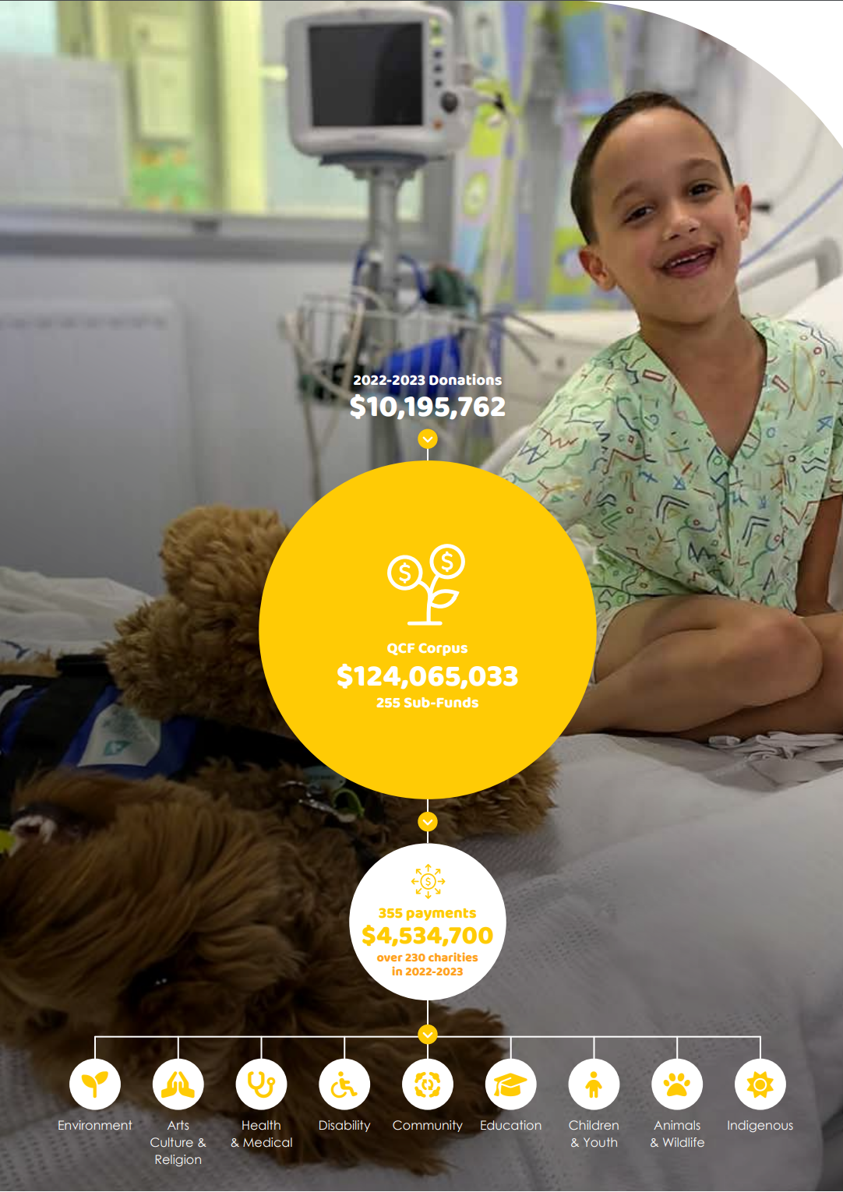
About Queensland Gives by Queensland Community Foundation
In November 2023 Queensland Community Foundation changed its name to Queensland Gives.
Queensland Gives is a perpetual charitable fund comprised of a General Fund and 255 managed sub-funds.
Established in 1997 by former Queensland Premier The Honourable Mike Ahern AO, with just $300k, QCF was set up to serve Queensland communities by providing an enduring funding source for charities.
In 2023, QG reached the incredible milestone of $124 million in charitable funds under management and since inception has distributed over $39 million to hundreds of Queensland charities.
QIC has supported Queensland Gives by Queensland Community Foundation since the very beginning (1997):
- As Founding Sponsor
- Our fund manager
- Queensland Gives team sits on L4
- IT equipment and support
- HR and Legal support
- Volunteers, Board and committee members

Slide 74
How does Queensland Gives work?
Queensland Gives provides a philanthropic vehicle, with no set-up administrative costs for those making a gift, thanks to our Founding Partners QIC and Anglo American, covering staff and administrative costs.
Queensland Gives handles the tax, audit and governance issues of all donations large and small.
Queensland Gives is made up of the following funds:
GENERAL FUND
(balance $15.5M)
The purpose of the General Fund is to provide enduring support to Queensland charities through an annual grants program. DGR1 Queensland charities can apply for grants of up to $30,000 for capacity building projects
REGIONAL SUB-FUNDS
(10 across QLD)
A regional sub-fund’s purpose is to encourage donors to “give where you live” – funds stay in the community it is given – forever. Currently there are regional sub-funds in Toowoomba, Gold Coast, Sunshine Coast, North Queensland, The Gulf and Bayside (Lytton electorate).
CHARITY SUB-FUNDS
(124 charity specific funds)
Any Queensland charity, small or large, can set up their own charitable sub-fund, with income supporting their cause now and forever. Existing charity sub-funds include: Cancer Council Queensland, RSPCA, QLD Library Foundation, The Prince Charles Hospital, Royal Flying Doctor Service, National Parks Assoc of Queensland and more.
NAMED SUB-FUNDS
Any individual or business can to create a named sub-fund to create a perpetual income stream for a charity, cause or region.
A named sub-fund can be a living gift or named in a will. In 2020, QIC set up an employee sub-fund to benefit the causes most important to their staff group
SUB-FUNDS IN MEMORIAM
A sub-fund in memoriam honours a loved one, leaving a perpetual legacy in their name. In 2006, Anglo American set up The Greg Garrick Foundation in memory of their HR staff member. This fund provides a scholarship for a student at James Cook University distributing approximately $1,500 each year

Slide 75
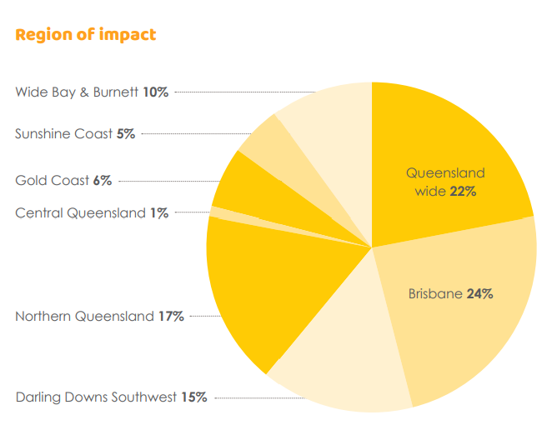
Queensland Gives General Fund Impact across the state in the 2023 grant round
From $3,000 to $30,000, Queensland Gives General Fund grants have a profound and long-lasting impact in our communities.
In 2023, the General Fund grant program focussed on mid-tier charitable organisations strengthening community through collaboration. 20 grants totally $651,497 from the General Fund were awarded to organisations across the state.

Slide 76
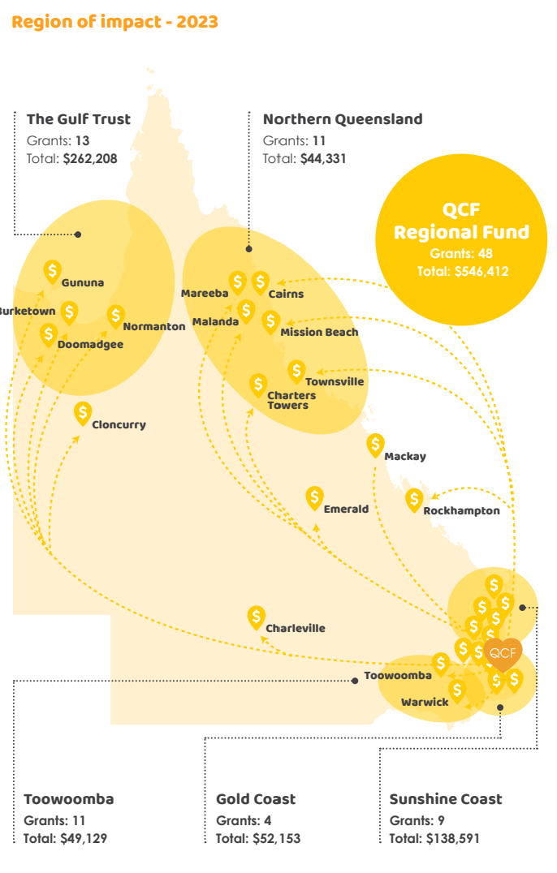
Queensland Gives Regional Funds Impact across the state in the 2023 grant round
Queensland Gives regional grants program supports Northern Queensland, Gold Coast, Sunshine Coast, Toowoomba, and the Lower Gulf Region which services the communities of Burke Shire Council, Carpentaria Shire Council, Doomadgee Aboriginal Shire Council and Mornington Shire Council.
Charities and causes that receive support through a regional grant demonstrate the following:
A one-off project for a specific purpose
Demonstrated sustainability beyond funding period
Strengthening the community
Reducing social disadvantage
Helping find solutions to community problems
Benefiting as many people as possible

Slide 77
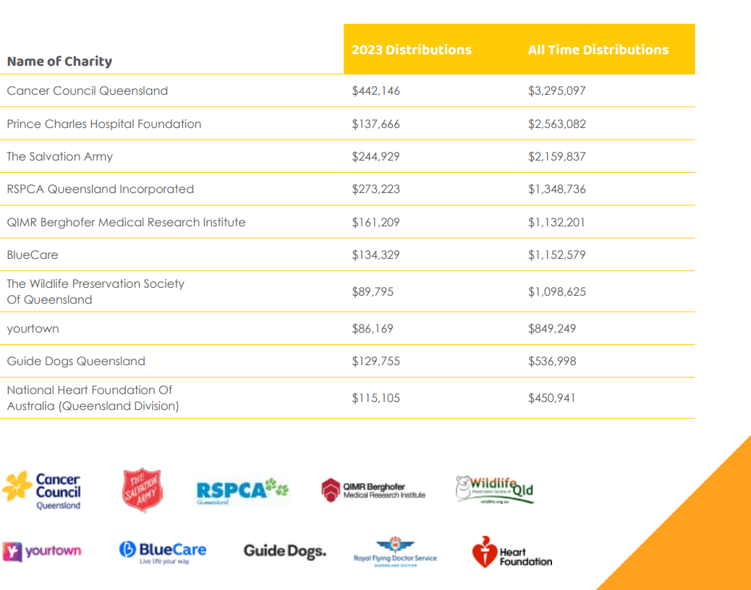
Top ten Queensland charities supported

Slide 78
Queensland Gives by Queensland Community Foundation Events and Campaigns in 2024
2023 Grants Presentations
CLOSES 15 DEC
Philanthropy in Focus Photo Challenge
OPENS FEBRUARY 2024
Queensland Philanthropy
Award nominations
OPENS MARCH 2024
Our biggest distribution in our history!
General Fund and Regional Funds grant round: Toowoomba, Gold Coast, Sunshine Coast, Bayside and Northern Queensland.
Enter a photo to win your favourite charity $2000. Photographers and NFPs tell their stories using the power of photography to reflect kindness and philanthropy in Queensland.
Nominate an inspiring Queensland philanthropist in seven categories: corporate, community, emerging, innovation, foundations, SME and environment.
Queensland Philanthropy Week Launch - 3 June
Parliament House
Queensland Philanthropy
Award Lunch – 7 June
Brisbane City Hall
A VIP launch at Parliament House for partners, special guests and media hosted by Speaker of the House Hon. Curtis Pitt MP and QCF Board
Premium corporate event celebrating community members and organisations who make outstanding philanthropic contributions.
Ash Barty is our special
guest speaker

Slide 79
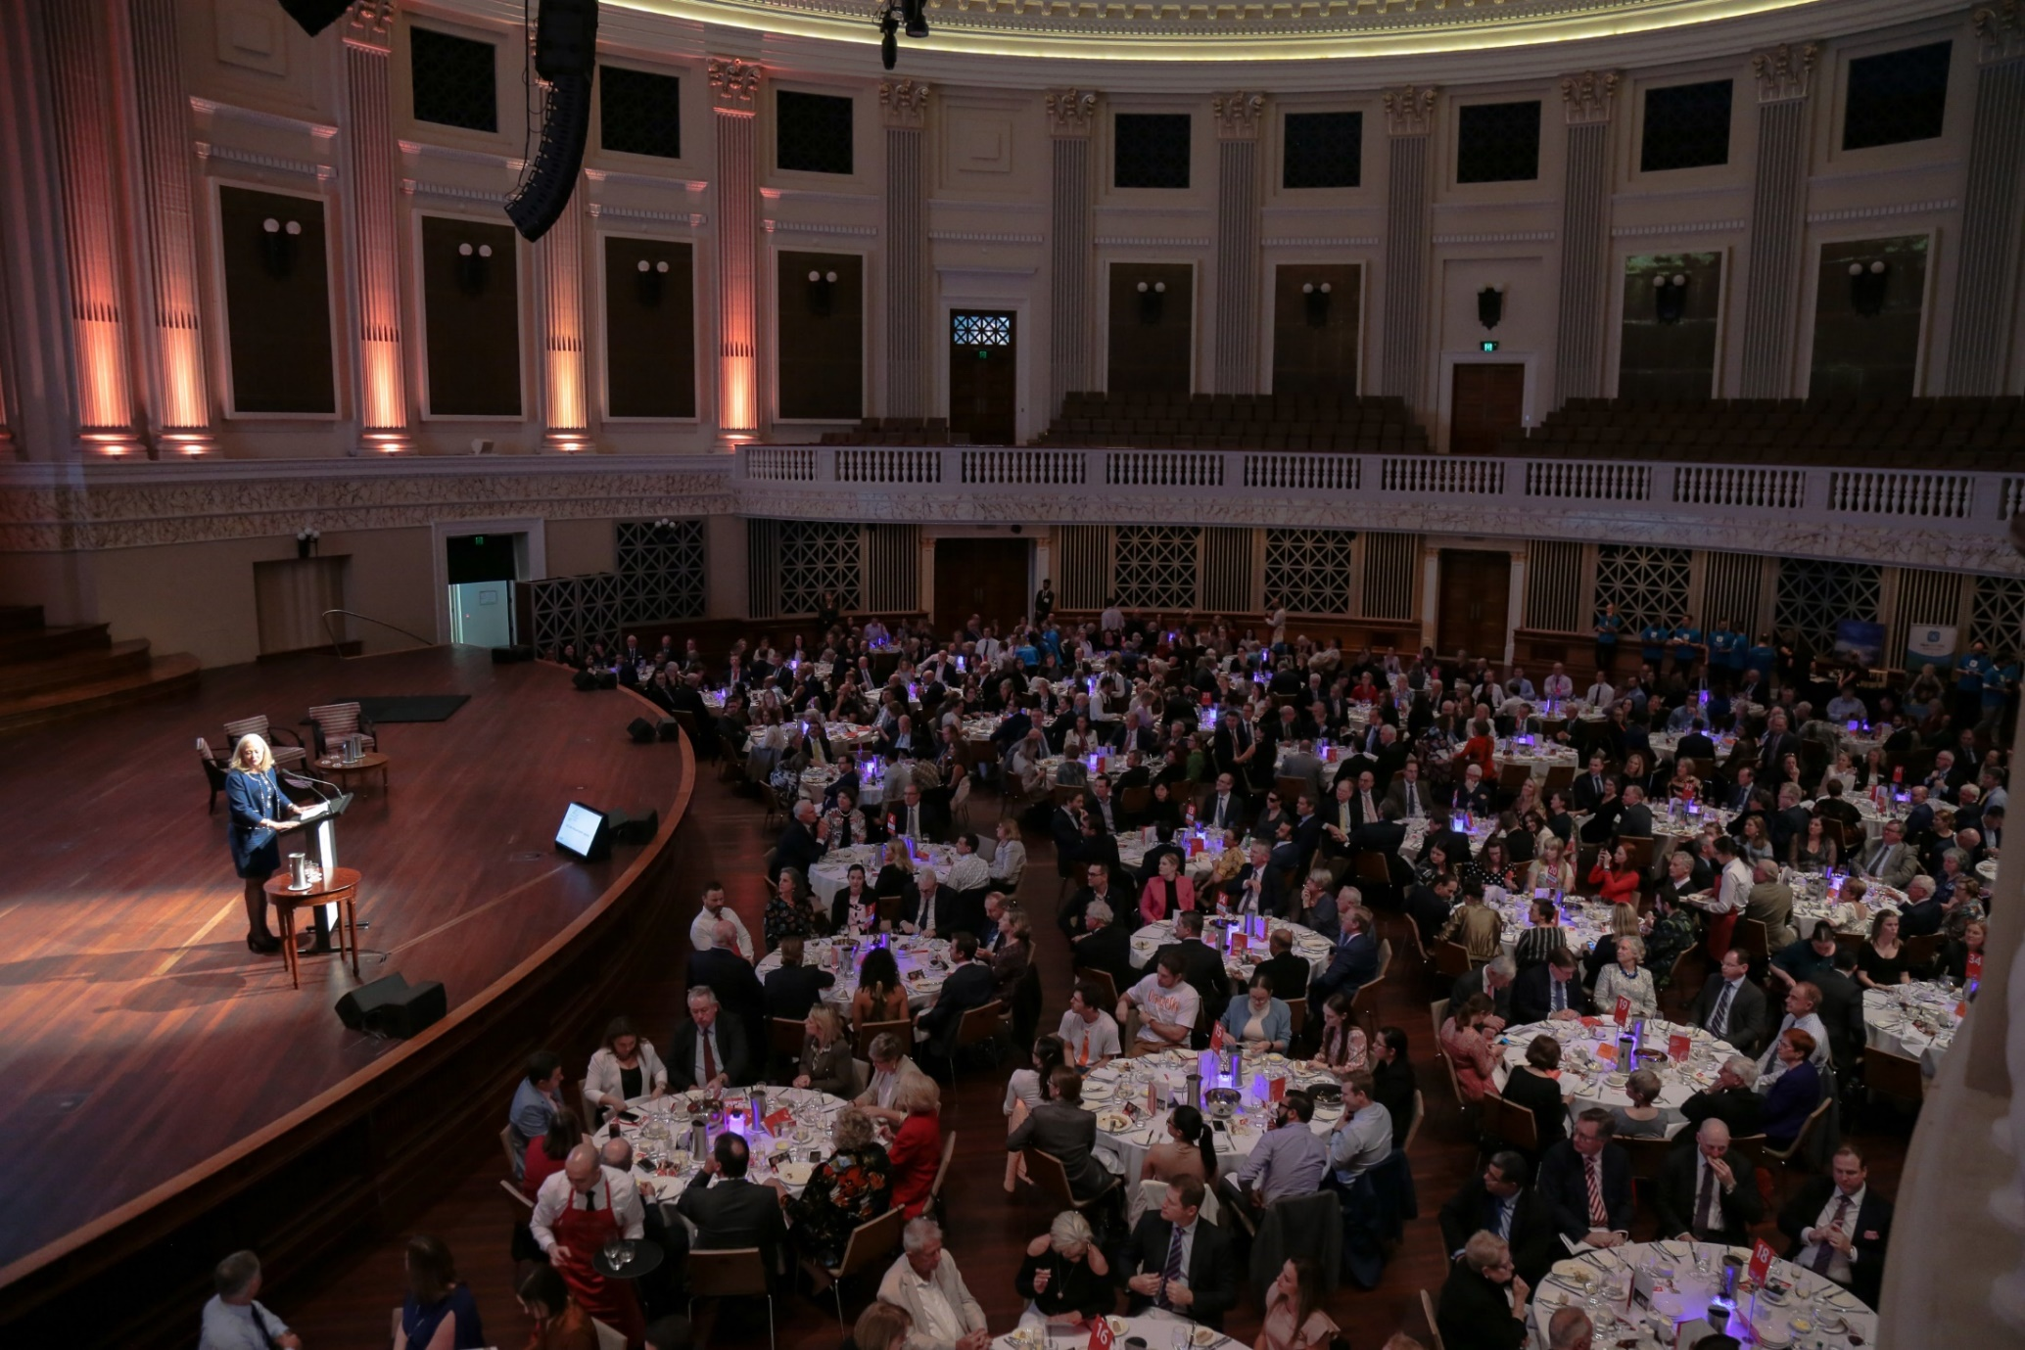
Queensland Philanthropy Week 2024
7 June 2024 marks the 14th Annual
Queensland Philanthropy Awards
Queensland Philanthropy Week is an annual celebration of philanthropy. It is a high-profile week where we honour community members and organisations who make outstanding philanthropic contributions.
Queensland Philanthropy Awards presents an inspiring and engaging opportunity to align with hundreds of like-minded philanthropists, charities, corporations and community causes across the state.

Slide 80
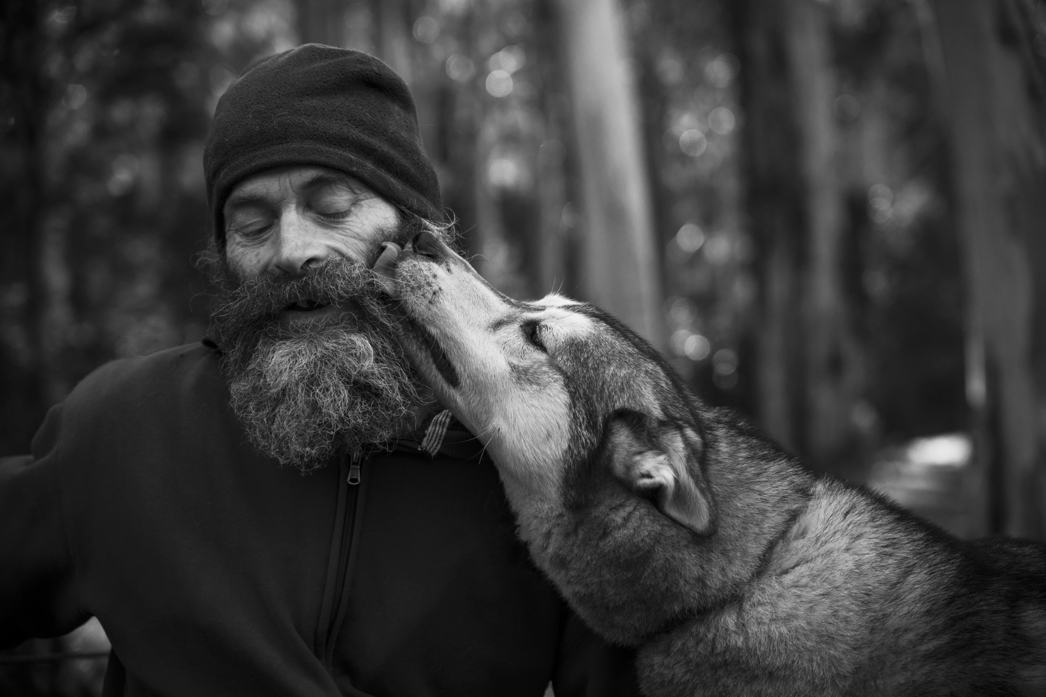
From little things big things grow
Questions?
Tara Castle
Chief Executive Officer tara@qcf.org.au
“A man and his dog” by Lachlan Robertson 2019 QCF Photo Challenge entry

