Slide 1
Community Consultation
Lake McDonald Drive
7 April 2025

Slide 2
PURPOSE
Introduce you to Coast2Bay Housing Group and its work
Provide opportunity for feedback and questions from you
Explain what Community Housing is and how it operates
Demonstrate what safeguards there are in the community housing operating model
Outline the national, state and local need for community and affordable housing
Provide some visuals of what community housing designs look like
Provide some high level details of the Lake McDonald Drive development

Slide 3
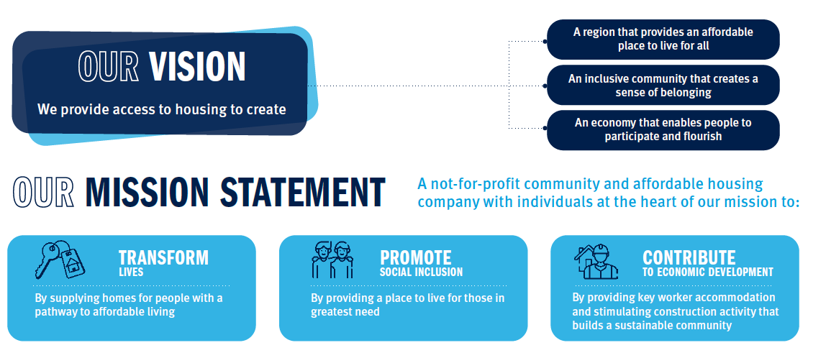
About Coast2Bay

Slide 4


Focus on Tenants and Community / Neighbourhood and Place Making

Slide 5
COMMUNITY AND AFFORDBLE housing system and models
Social Housing –
Income Based Rents (25%-30%)
Affordable Housing / Household Type and Income
Affordable Housing – Discount to Market Rents (BTR)
Eligibility and needs based test – register of need
Eligibility and compliance tests
Crisis Accommodation
Community Housing (NRSCH)
Affordable Housing
Income Based
no more than 30% and
certain household types
National Rental Affordability Scheme, HIF and HAFF and others models such as BTR
Indigenous Housing
Public Housing

Slide 6
The HOUSING CONTINUUM / NEED
Housing Needs and Diversified Income Streams
Community housing providers (CHPs) are not-for-profits that re-invest surplus revenue into new housing, better services or improving our properties – not into dividends for shareholders. We operate a variety of housing types across the spectrum of need.
Crisis Accommodation
Transitional Housing
Social Housing
Affordable Housing
Private Rental
Home Ownership
Social Housing is for people on very low incomes who can’t find suitable accommodation in the private rental market. It provides homes for some of the most vulnerable in the community, including very specific needs such as escaping DFV, homelessness and people with disability. Rent is usually 25-30% of income.
Affordable Housing is usually defined as housing that is rented at a lower than market rate, often specifically for essential or key workers who have low to medium income levels. Rent is typically 75% of market and should be no more than 30% of household income.

Slide 7
Safeguards in operational Practice (1)
National Regulatory System for Community Housing (7 Outcomes Annually Audited)
Tenant and housing services
Housing assets
Community engagement
Governance
Probity
Management
Financial viability
Complaints to the Minister of Housing (Queensland) and complaints system open to the public www.nrsch.gov.au

Slide 8
Safeguards in operational Practice (2)
Allocation process
Register of need in Queensland
Allocation decisions only made by Coast2Bay Housing Group
Comprehensive individual needs assessments
Allocating for success – seeking to blend allocations in the best way
Specific allocation protocols with the Department
25% of allocations can be made by referrals directly to the CHP (but must be eligible)

Slide 9
Safeguards in operational Practice (3)
Community and Tenant Engagement (policy, process and resources)
The International Association of Participation (IAP2)
Inform
Provision of information
Consult
Opportunity for comment, feedback and discussion
Involve
Opportunity for participating in decision-making
Collaborate
Empower
Working together to make decisions
Decision-making handed over to community

Slide 10
Safeguards in operational Practice (4)
Community and Tenant Engagement (policy, process and resources)
Practice Aims
Support quality tenancy experiences and sustainable homes
Facilitate the development of resilient, active and sustainable communities
Enhance well-being, identity, social connectedness and belonging in community
Build skills and capability of individuals and community
Create co-design processes that support individuals and communities to identify and achieve community owned activities and projects (e.g. community garden)
Collaborations and partnerships with the range of community stakeholders
Access funding programs and sponsorships to grow resources

Slide 11
Safeguards in operational Practice (5)
Tenancy and Property Management
Dedicated tenancy manager (relatively low ratios)
  Mutual obligations
  Rent
  Quiet enjoyment
  Partnerships with support agencies
Property and asset manager teams
  Tenant care for property
  Response and cyclical maintenance
Breaches and zero tolerance
Managed exits if required

Slide 12
Sunshine Coast AND NOOSA Challenges (1)
Source: Smarter Cities 2019 (Housing Policy, Research)
Percentage Population Growth
Median Housing Price
3.00%
2.50%
2.00%
1.50%
1.00%
0.50%
0.00%
-0.50%
$1,400,000.00
$1,200,000.00
Percentage
Dollars $
$1,000,000.00
$800,000.00
$600,000.00
$400,000.00
$200,000.00
$0.00
Mackay
Launceston Townsville
Darwin Adelaide Newcastle
Cairns Toowoomba
Perth Wollongong
Hobart Albury -… Bendigo Ballarat Sydney Canberra Brisbane
Western Sydney Gold Coast -…
Sunshine Coast Melbourne Geelong
Townsville
Albury - Wodonga
Launceston
Mackay Bendigo Ballarat Toowoomba
Cairns Darwin Hobart Adelaide Newcastle
Perth Geelong Brisbane Canberra Sunshine Coast
Gold Coast - Tweed
Wollongong Western Sydney
Melbourne
Sydney
House Price to Income Ratio
Social Housing as % of all dwellings
10
9
8
7
6
5
4
3
2
1
0
8.00%
7.00%
Ratio
Percentage
6.00%
5.00%
4.00%
3.00%
2.00%
1.00%
0.00%
Darwin
Townsville
Albury - Wodonga
Mackay Toowoomba Canberra
Cairns Bendigo Launceston
Ballarat Perth Brisbane Hobart Adelaide
Gold Coast - Tweed
Geelong Newcastle Melbourne Sunshine Coast
Sydney Wollongong Western Sydney
Gold Coast -…
Sunshine Coast Melbourne Toowoomba
Perth Geelong Brisbane Cairns Bendigo Townsville Ballarat Sydney Mackay
Albury - Wodonga
Darwin Newcastle Western Sydney
Hobart Adelaide Canberra Launceston Wollongong

Slide 13
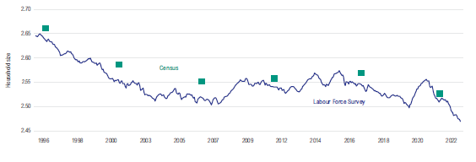
Sunshine Coast AND NOOSA Challenges (2)
Source: NHFIC (HOUSING AUSTRALIA) – March 2023
Supply additions / household formation
Long term trends – household formation size

Slide 14
Sunshine Coast and Noosa Challenges (3)
Social Housing Demographics – Existing Regions
Moreton Bay, Sunshine Coast, Noosa, Gympie. n = 4,227 households
Source: Qld Govt. Social Housing Register, 30 September 2024 Data File.

Slide 15
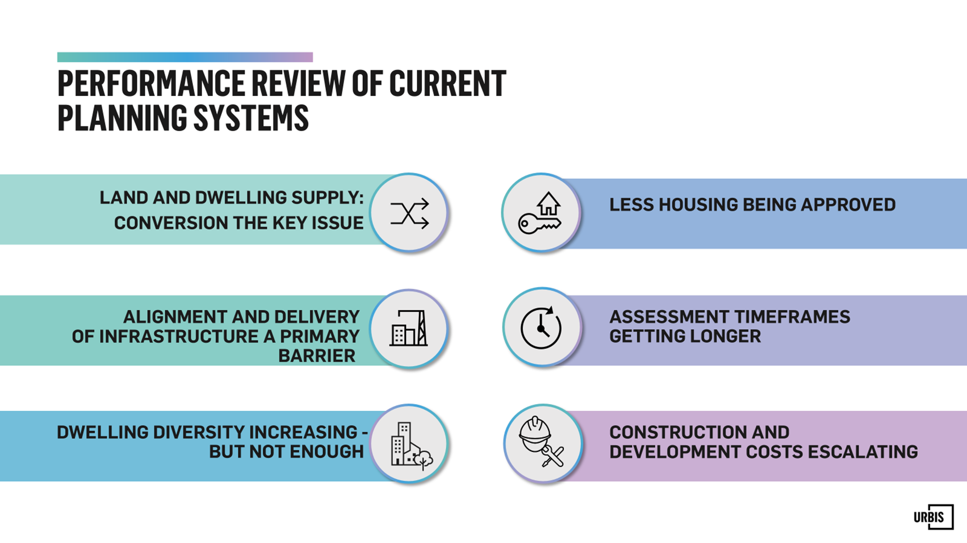
National Challenges and POLICY MAKING (1)
Source: Urbis September 2024

Slide 16
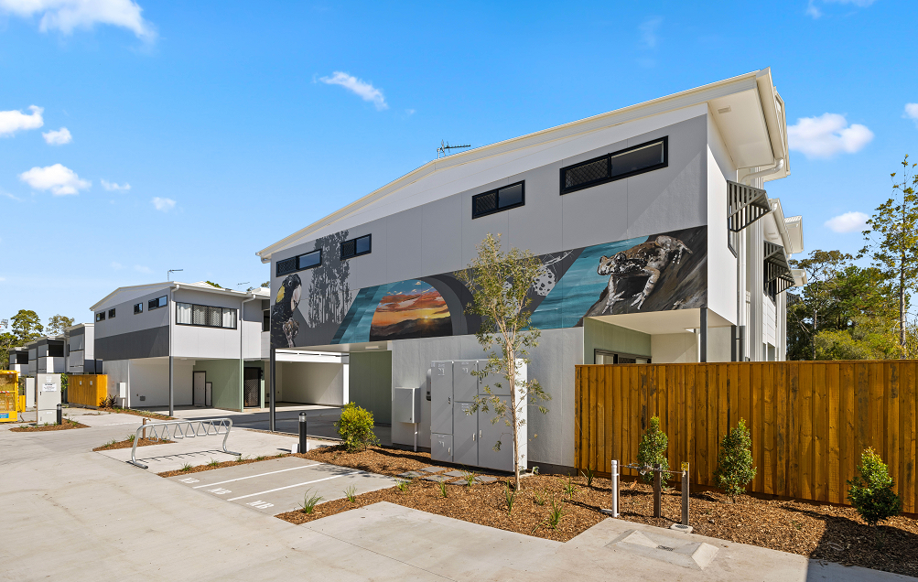
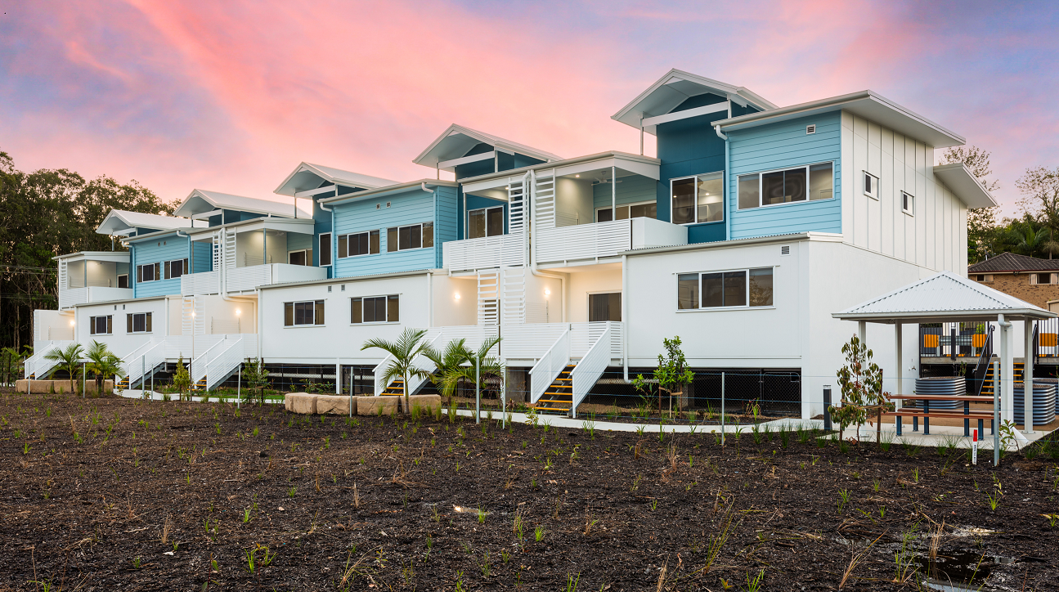
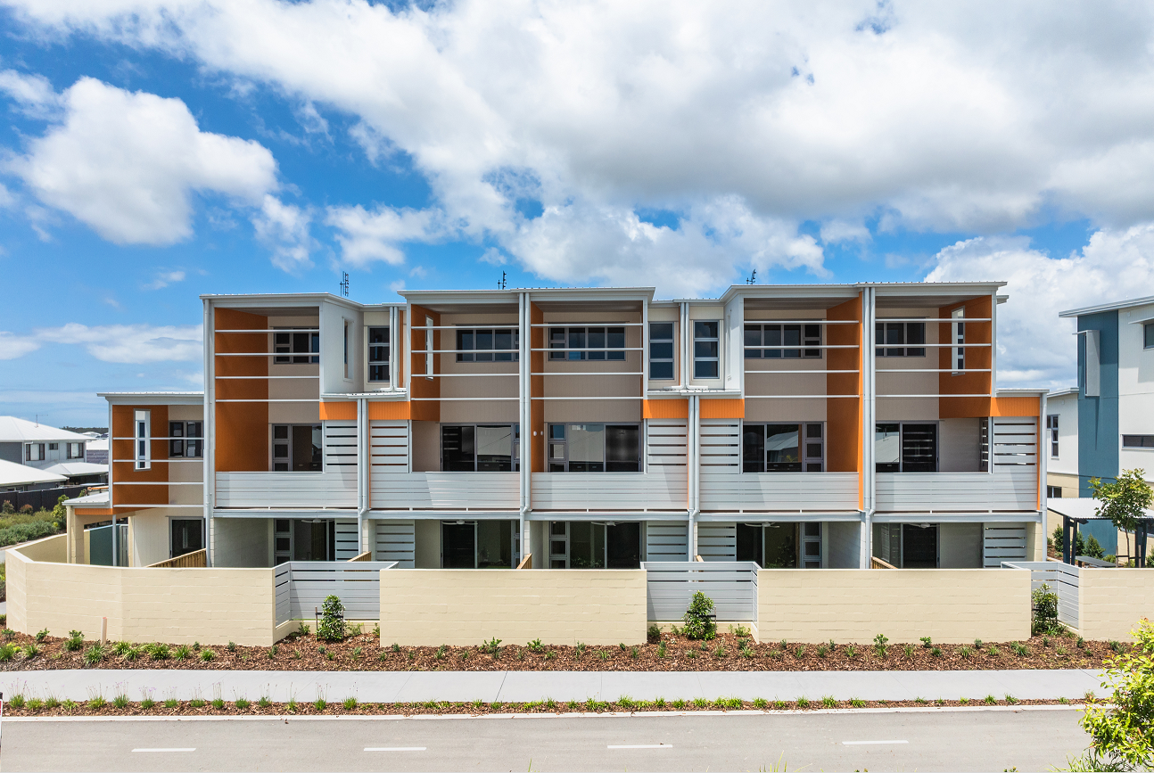
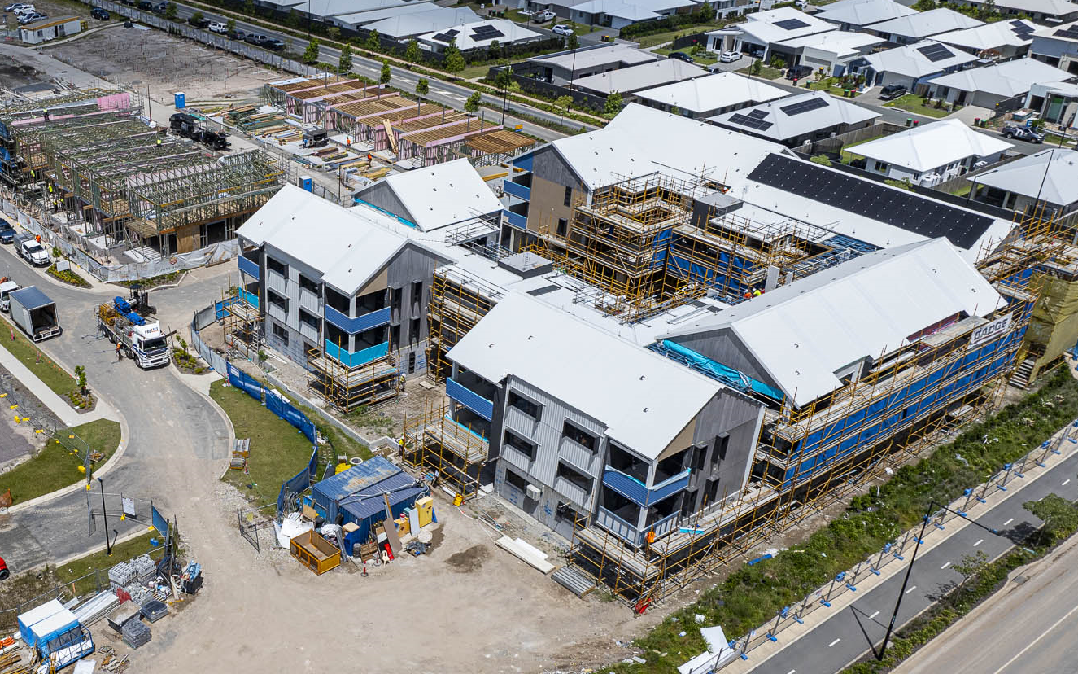
RECENT PROJECT EXAMPLES

Slide 17

PARTNERSHIP PROJECTS (One Example)
BTH continues to evolve and grow as a unique, women-led, community driven response to homelessness
Increasing in membership, active participation and successful housing outcomes
An Advocacy Action Plan is being implemented by the BTH team, members and community supporters
Resources to support expansion from July 2025 in budget submission

Slide 18
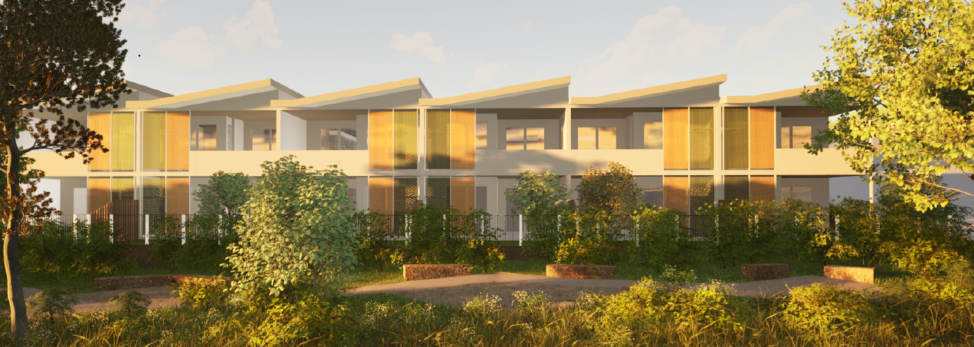
Lake McDonald Drive
Demographic Groups
People living with a disability
Seniors
  Fixed income pensioner couples
  Single Older Women
Families (DFV)
Built Form
15 (1 bed, 1 bath and 1 car) – 66 sqm
10 (2 bed, I bath and 1 car) – 95 sqm
High level of accessibility (LHA Gold)

Slide 19
PURPOSE – CHECK LIST
Introduce you to Coast2Bay Housing Group and its work
Provide opportunity for feedback and questions from you
Explain what Community Housing is and how it operates
Demonstrate what safeguards there are in the community housing operating model
Outline the national, state and local need for community and affordable housing
Provide some visuals of what community housing designs look like
Provide some high level details of the Lake McDonald Drive development

Slide 20
Thank you
Disclaimer: This presentation has been prepared for general information and engagement purposes for the audience identified on the first slide or cover page only. This document must not be provided to any third party without the written consent of Coast2Bay Housing Group. The information contained in this presentation is current as of the date of the presentation only and must be not relied upon or used for any purpose other than that expressly identified by Coast2Bay.

